Slide 1
Update on Global Polio Eradication Initiative
PPG Meeting, 26 October 2023

Slide 2
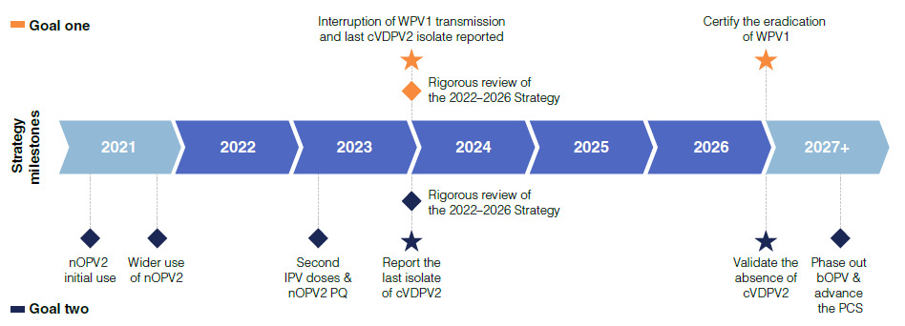
Polio Eradication Strategy 2022-26
Mid-term review of the strategy just concluded (Independent Monitoring Board issued 22nd Report

Slide 3
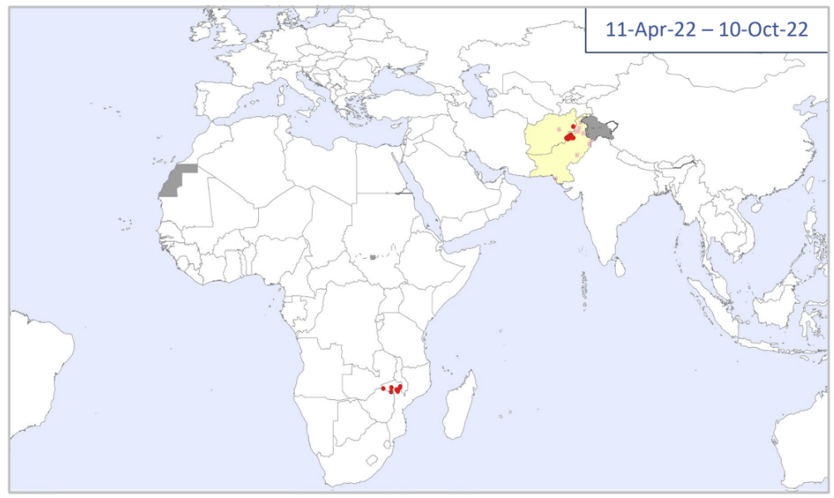
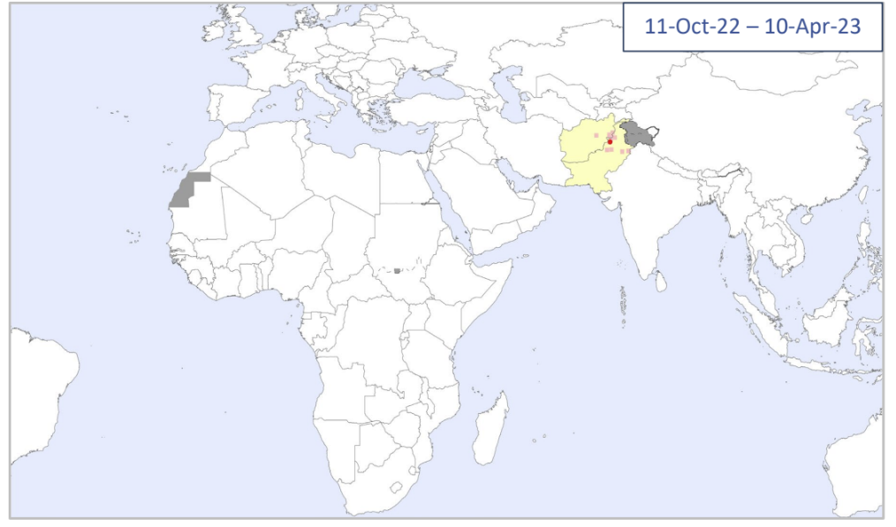
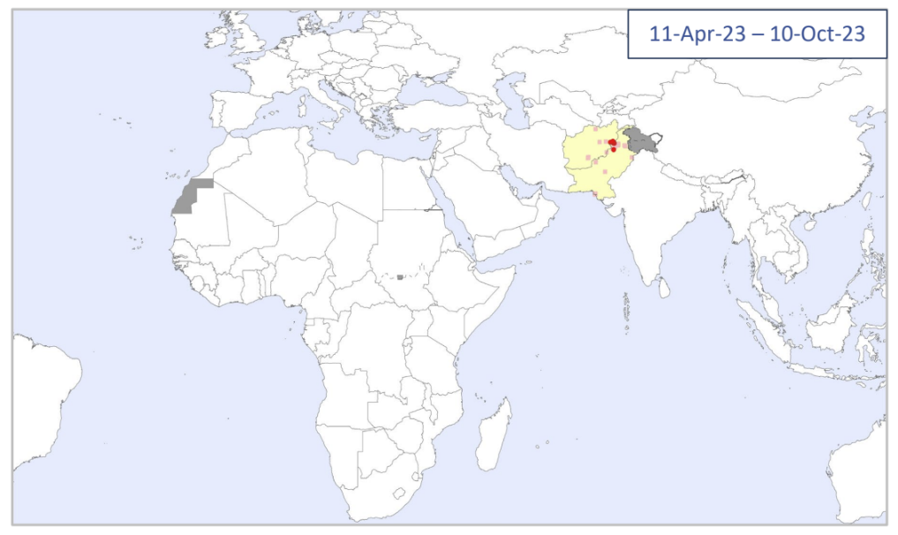
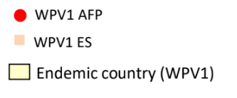
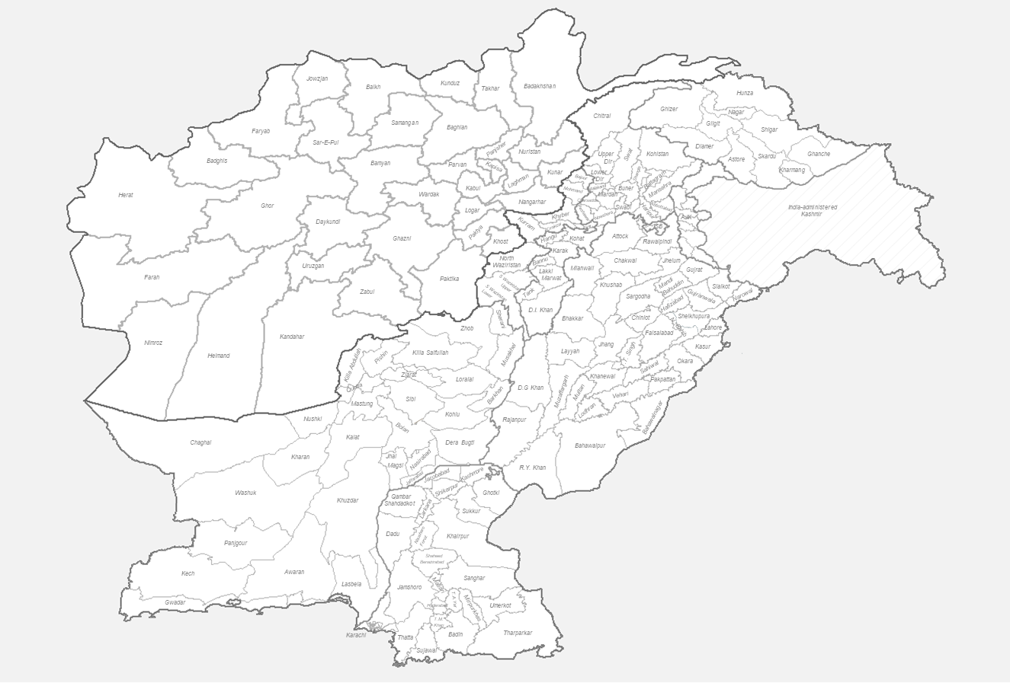
Where are we on Goal 1—Stop WPV1 transmission by end 2023?
Global WPV1 isolates¹
Malawi-Mozambique:
No WPV1 reported since last 14 months—following the importation detected in Nov 2021
Assessment planned in November--possibility of closure of WPV1 outbreak in Mozambique—Malawi
Afghanistan:
Six WPV1 cases reported this year – all from Nangarhar province—Most of the detections from Env Sites (sewage water samples) are also from Nangarhar
WPV1 detections from Env Site of Kandahar with genetic linkages with Nangahar, poses major risk for overall Southern corridor of transmission. Multiple rounds of SIAs implemented in Nangarhar as part of intensified efforts
Pakistan:
Four WPV1 cases reported this year – Three from Bannu district in the southern area of Khyber Pakhtunkhwa (KP) and one from Karachi
Detection of WPV1 from the Env Sites of Peshawar block and recent detections from Karachi and Quetta block indicate new introductions but high risk of introductions leading to transmission
Intensified efforts continue to be implemented in the country, particularly in KP and core reservoirs of Peshawar, Karachi and Quetta block
WPV1 Cases and ES+, by Cluster, 2023
Case
ES Isolate
Light Blue = YB3A
Dark Blue = YB3C
WPV1 Cases
Afghanistan: n = 6
Pakistan: n = 4
¹includes viruses detected from AFP (onset date) and environmental surveillance (collection date)
Data in WHO HQ as of 19 Oct 2023

Slide 4
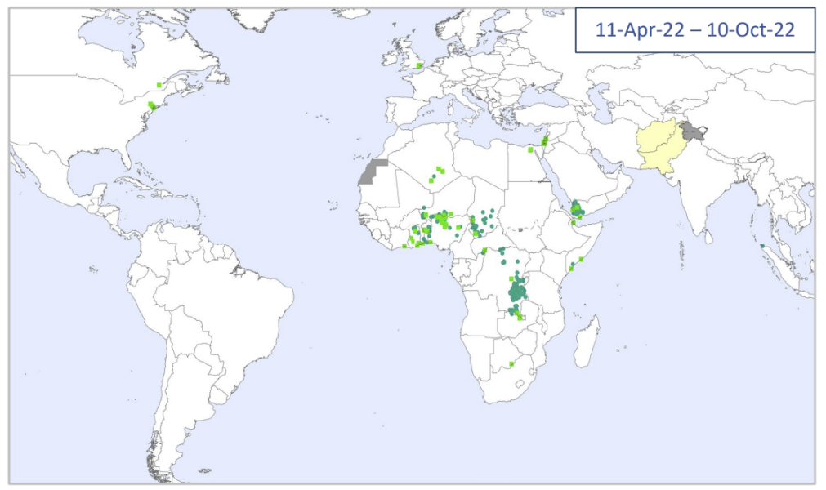
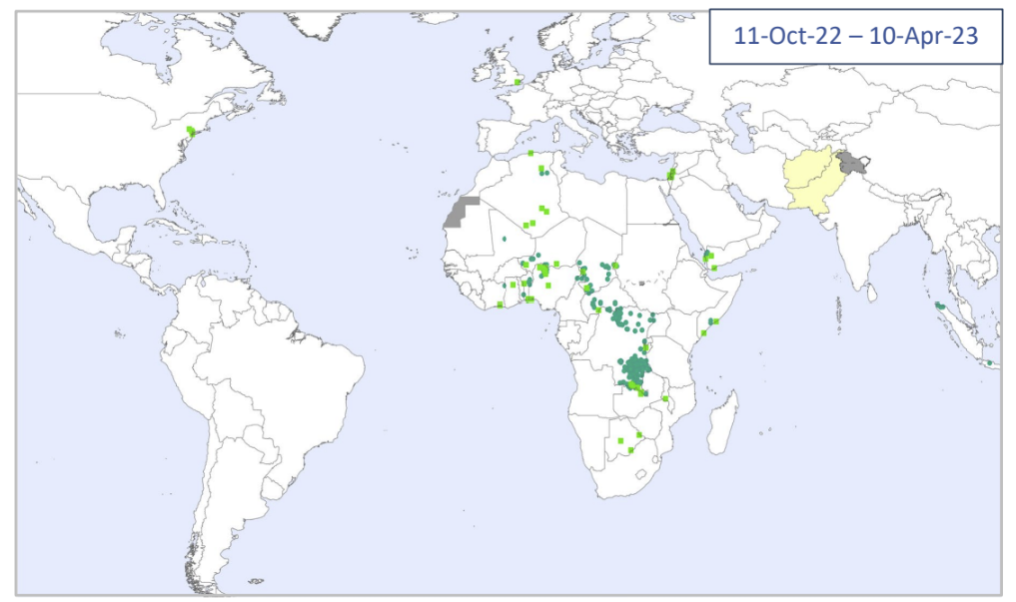
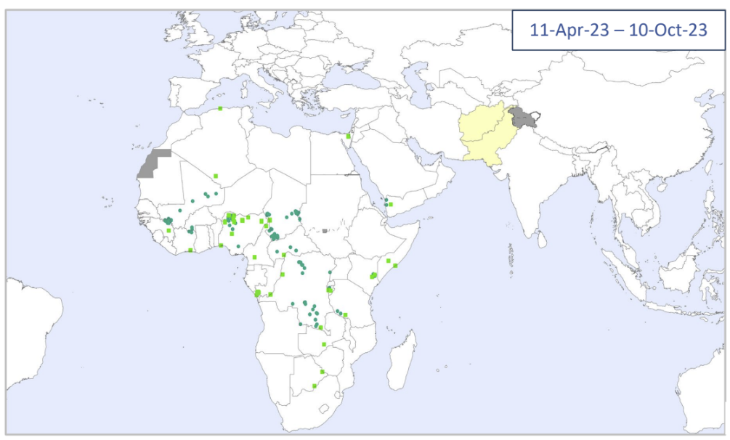
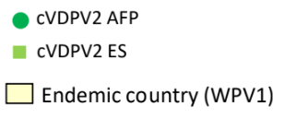
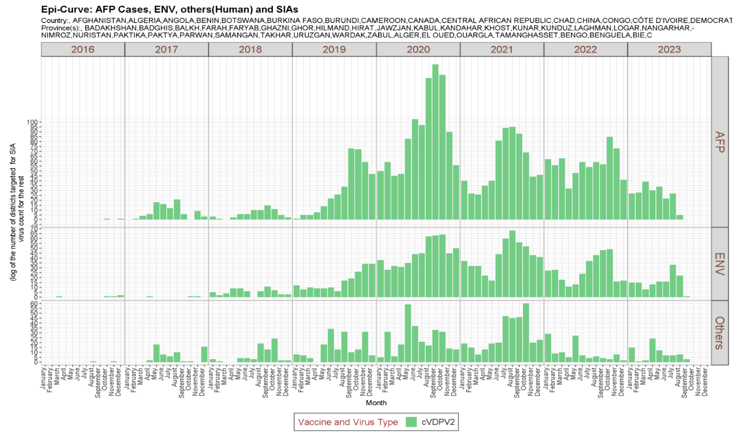
cVDPV2 global overview
Global cVDPV2 isolates¹
There have been 211 cVDPV2 cases YTD
The number of AFP cases since 2020 is consistently down
Since January 2022, cVDPV2 cases in DRC, Nigeria, Yemen, and Somalia have accounted for over 70% of global cases
The number of cVDPV2-infected districts is declining year on year
Global cVDPV2 AFP cases, environmental samples, and others
¹includes viruses detected from AFP (onset date) and environmental surveillance (collection date)
Data in WHO HQ as of 10 Oct 2023

Slide 5
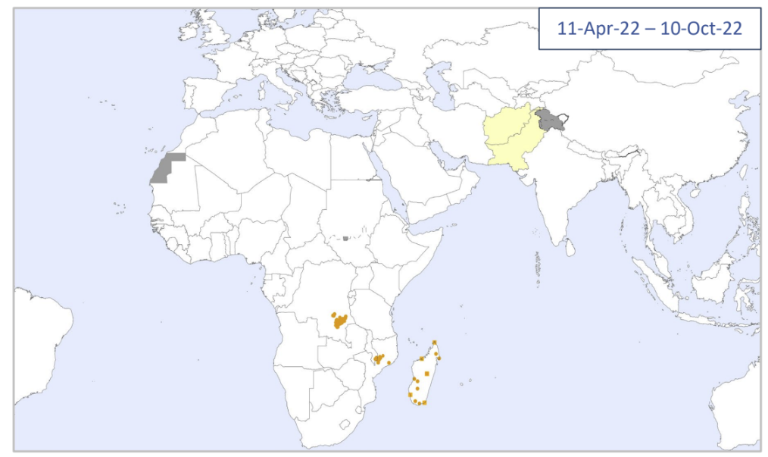
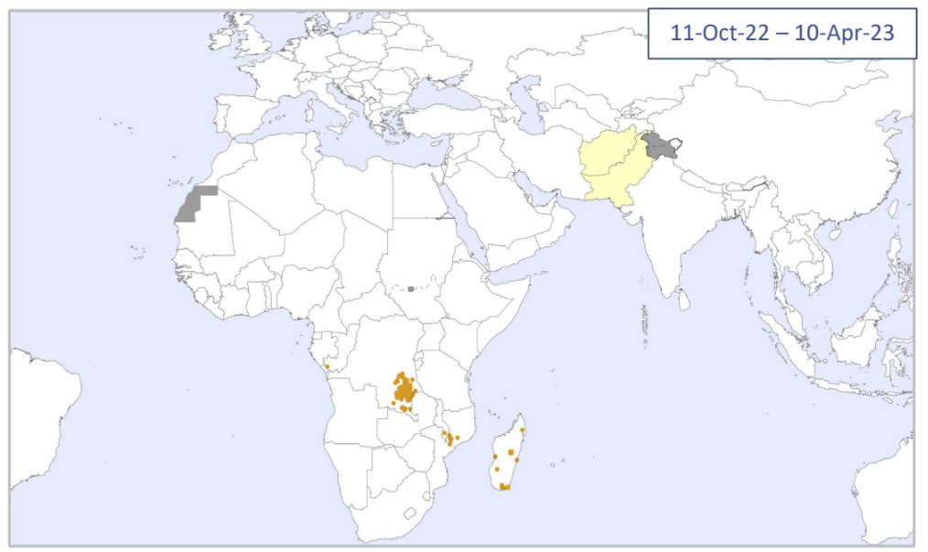
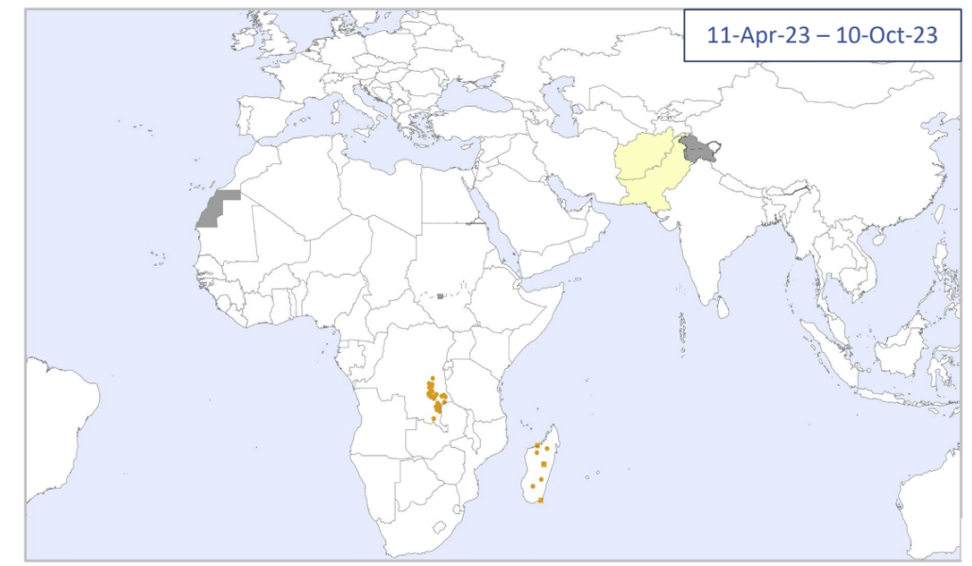
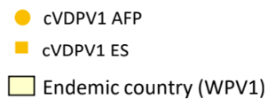
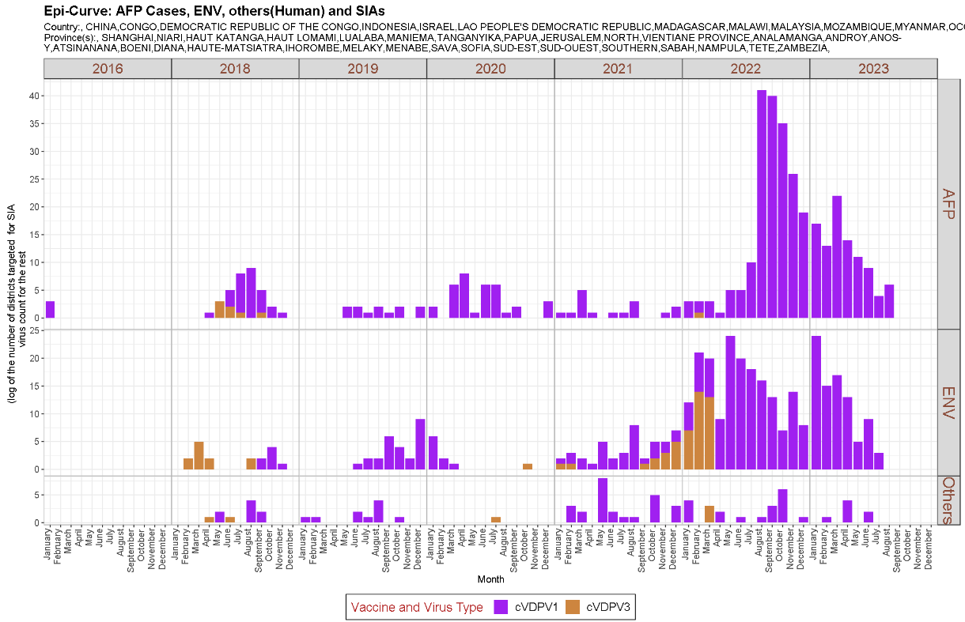
cVDPV1 global overview
Global cVDPV1 isolates¹
Since 2016, 14 cVDPV1 outbreaks from 12 emergences have been reported across 10 countries
In 2023, 95 cVDPV1 cases have been reported across three countries - DRC, Madagascar, and Mozambique
In countries experiencing cVDPV1 outbreaks, poor coverage of bOPV and IPV from routine immunization and the deprioritization of bOPV preventive campaigns have negatively affected population immunity
Global cVDPV1 AFP cases, environmental samples, and others
¹includes viruses detected from AFP (onset date) and environmental surveillance (collection date)
Data in WHO HQ as of 17 Oct 2023

Slide 6
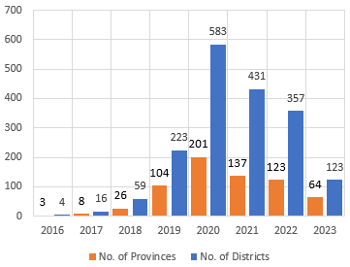
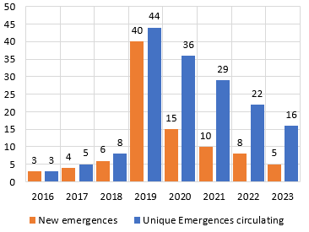
Goal 2 summary: downward trend needs to be accelerated
New cVDPV2 cases and emergences appear to be declining, but ongoing inaccessibility and security risks fuel transmission in the most consequential geographies
Goal 2 of the current strategy is focused on cVDPV2, but the programme has adapted to two major events since 2022: (1) the importation of WPV1 in southeast Africa, and (2) an explosive cVDPV1 outbreak in eastern DRC
The response to the Type 1 outbreaks is being managed through existing strategy and budget, and GPEI will continue to respond to all outbreaks, irrespective of type
The programme has planned a scaled-up, aggressive response tailored to specific geographies in 2024 to accelerate “the path to zero” and stands unequivocally behind the tools (e.g., vaccines) at its disposal
Areas of focus:
Immediately proximate geographies
Areas that are constantly re-infected
A sharper approach to new outbreaks, focused on timeliness
Number of countries with cVDPV2 and cVDPV1
Provinces and districts with cVDPV2
Emergences of cVDPV2
Data in WHO HQ as of 15 August 2023

Slide 7
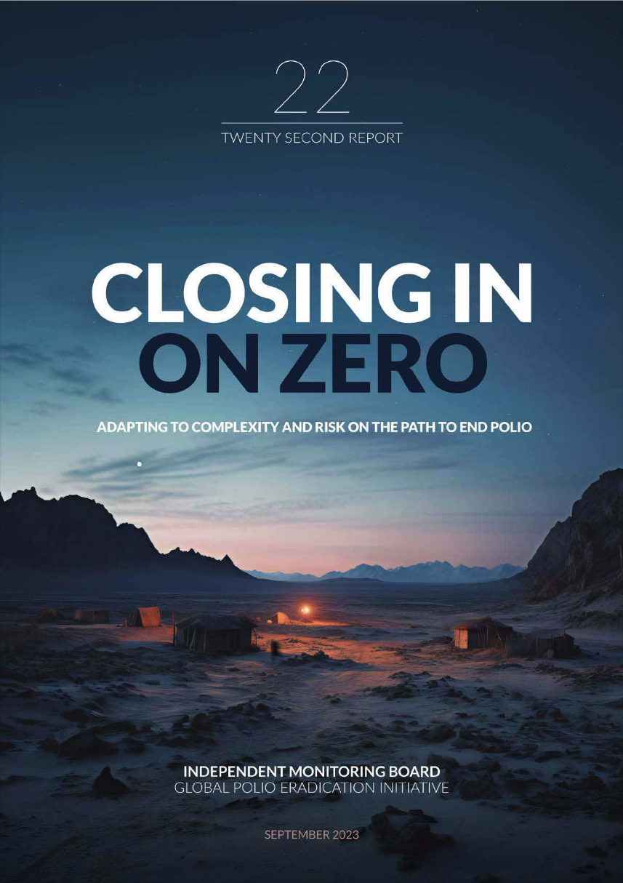
We are closing in on zero, despite delays to ambitious timelines
The Independent Monitoring Board’s 22nd Report and Mid-Term Review highlights the very real successes and challenges of the GPEI’s polio eradication efforts—Program agrees with IMB’s assessement
We believe WPV1 eradication can still be certified in 2026 and do not foresee changes to this timeframe despite interruption efforts extending beyond 2023
The programme agrees with the IMB assessment that the 2023 cVDPV2 goal will be missed; and believes that interruption can be achieved—efforts to be extended beyond 2023 through intensified outbreak response activities
We recognize the pressing technical, community engagement, local and geopolitical challenges before us. Security and instability in key geographies pose a singular challenge
The programme is clear-eyed about the risks highlighted by the IMB and is addressing those that are most important to the programme’s goals
IMB MTR assessment
Goal One | Goal Two
Off track | Will be missed

Slide 8
Closing in on zero in the world’s most challenging contexts
Insecurity, inaccessibility, and political challenges are the biggest risks for the programme
1
2
Endemics
Though one epidemiological block, the Afghanistan–Pakistan operating dynamic is complex
The EMRO sub-committee on Polio Eradication and Outbreaks will undergo an important leadership transition with RD’s departure
Consequential geographies
DRC (Eastern)
Insecurity, armed conflict, large numbers of IDPs
Elections scheduled for December 2023
Challenges with campaigns due to complex environment, weak logistics, and inaccessibility
Nigeria (Northwest)
3 front-line workers killed; 13 taken hostage; insurgency and banditry in key states
>3.9M children in 31K settlements inaccessible
Strong local partnerships; Dr. Pate’s recent appointment as health minister
Afghanistan
World’s largest humanitarian crisis, continues to deteriorate with very few international health actors left in the country
Engagement of regional partners is critical
Challenges reaching persistently missed children
Kandahar an ongoing concern
Pakistan
Economic and humanitarian challenges coupled with political and security challenges
Programme continues to miss a large number of children; approximately 50,000 children in the region (south KP) are regularly missed during OPV SIAs
Increased security management challenges during political transition
Somalia (Central)
For the first time, there are no fully inaccessible districts
Ongoing challenges related to famine, insecurity, and weak health systems
Phased withdrawal of the African Union troops, to be completed in 2024
Yemen (Northern)
Health emergency
Anti-vaccine sentiment in government
No campaign activities since outbreak began
Risk of spillover from northern governance to the wider region

Slide 9
We are implementing IMB recommendations based on priority and likely impact on interruption goals
 | No. | Priority | Recommended action | Notes
Goal 1 | 6 | High | Continue working closely with provincial chief secretaries in Pakistan | Agree; will continue to do so
Goal 1 | 12 | High | Undertake advocacy with provincial governors in Afghanistan | Agree; pursuing all relevant opportunities
Goal 1 | 5 | Medium | Increase the number of campaigns planned in the endemics in 2023 | Agree in principle; adhering to existing campaigns and following epi
Goal 1 | 9 | Medium | New EMRO regional director should prioritize the regional subcommittee | Agree and should happen in natural course; POB engaging
 | 7 | Low | Order an independent audit in eastern Afghanistan | Agree would be interesting, but lower priority and poses challenges
 | 8 | Low | Carry out a serology study in eastern and southern Afghanistan | Agree in principle; inaccessibility remains key issue
 | 14 | Low | Convene a high-level meeting on developing a health system in Afghanistan | Agree in principle; beyond GPEI’s remit; willing to contribute
Goal 2 | 3 | High | Extinguish cVDPV1 in Africa | Agree
Goal 2 | 2 | Medium | Carry out budgetary review | Agree in principle and is underway
Goal 2 | 4 | Medium | Immediately introduce direct detection technologies | Agree in principle; studies underway and approval timelines remain TBC
 | 10 | Low | Reconvene presidential task force in Nigeria | Agree; and has already been done
 | 13 | Low | Organize a high-level summit on strengthening Nigerian primary health care | Agree in principle; must be country-driven
Cross-cutting | 15 | High | Support integrated immunization campaigns | Agree and several integrated campaigns recently completed
Cross-cutting | 1 | High | Review IMB's list of risks and set out action being taken to resolve or mitigate each | Done; see GPEI response to IMB’s 22nd Report and Mid-Term Review
 | 11 | Medium | Prepare polio resilience plans | Agree in principle; underway at regional level and GPEI can support

Slide 10
Maintaining intensity and momentum—Goal 1
The Independent Monitoring Board’s 22nd Report and Mid-Term Review highlights the very real successes and challenges of the GPEI’s polio eradication efforts
The programme agrees with the IMB assessment that the 2023 WPV1 goal is off track and cVDPV2 goal will be missed. Program believes that certification of eradication can be achieved by the end of 2026 through intensified outbreak response activities
Goal 1: Maintaining intensity and momentum
GPEI is enhancing efforts managing current and anticipated future risks. Continue adjustments and refinements to reach missed children— particular attention on quality to interrupt transmission across the northern corridor (East Afghanistan and greater Peshawar area) and mitigate the high risk of transmission across the across the South Corridor (South Afghanistan, Quetta and Karachi block)
The calendar of supplementary immunization activities for Q4 of 2023 and Q1 2024 has been revised to respond to the evolving epidemiology and capitalize on the upcoming low transmission season
Older age group vaccination in Nangarhar and selected districts (four rounds)
Sustain political will and community ownership critical to address local, political and security challenges

Slide 11
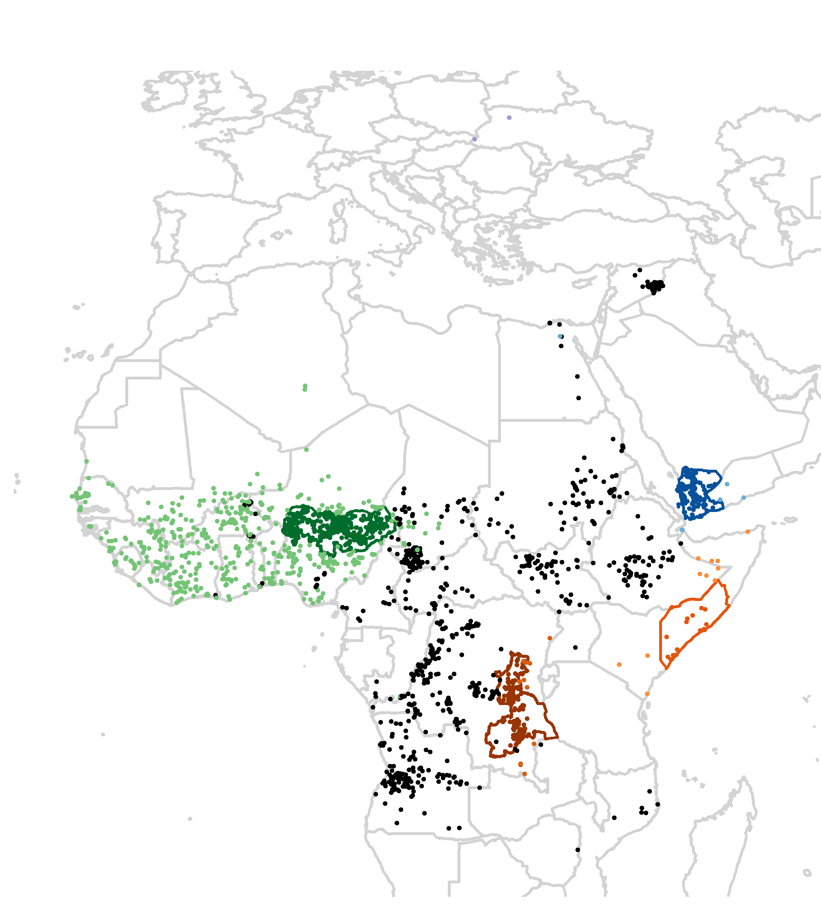
We remain focused on stopping transmission at the source in the most consequential geographies—Goal 2
We’ve restructured our outbreak response to focus on the most consequential geographies
Tailored immunization responses are bringing the full weight of the programme to bear:
In Nigeria, against a backdrop of inaccessibility, between-round activities, and polio vaccines with plusses are being designed and delivered settlement by settlement to reach missed children
In DRC, microplanning efforts are targeting specific areas and populations (e.g., Tanganyika)
Accessibility remains a challenge in Somalia, though health camps are successfully providing integrated health services
Northern Yemen remains almost entirely inaccessible due to anti-vaccine sentiment in government
Questions remain about how the programme can break through
Some hopeful signs with Houthi leaders and grassroots mobilisation (esp. around measles) but nothing definitive as yet
Additionally, the programme has increased focus on the 'ongoing outbreaks’ in countries immediately proximate to the consequential geographies to reduce importation, and is pre-positioning resources to assure timely response
Most consequential geographies
Northern Yemen
Four states in Northwestern Nigeria (Zamfara, Sokoto, Kebbi, and Katsina)
South-central Somalia
Three provinces in Eastern DRC (Maniema, Tanganyika, Haut-Lomami)

Slide 12
Integration activities will be a key support in reaching interruption
GPEI has launched an effort to develop its integration function collaborating with Gavi and the Essential Programme on Immunization (EPI), as well as with partners involved in health emergency response
Integration priorities will adjust as programme goals shift from interruption to certification – but current priorities are focused on efforts to reach interruption
Across critical geographies these primary integration activities include plusses, co-delivery and multi-antigen campaigns, and as engagement matures essential immunization strengthening, and integrated service delivery
Post-interruption, the focus of integration activities will shift to risk reduction, maintenance and strengthened surveillance preparing countries for GPEI Sunset
Global HQ
Identify government-driven integration priorities
Develop and implement integration plans, leveraging EOCs
Region
Country
Support country activities
Enhance coordination within the region and countries
Provide oversight and direction
Empower countries to find solutions
Facilitate GPEI coordination at all levels
The integration function will work to align roles and responsibilities across all actors, develop clear lines of accountability, and set standard process for tracking and communicating

Slide 13
Our assessment indicates that current Integration priorities vary by geography and over time
PRIORITIES
Continuum: from integration to transition and GPEI sunset**
Campaign-based
Coordinated health system strengthening activities
PRIORITY COUNTRIES FOR INTEGRATION Highest Near-Term Priority Country Critical Priority Country in 2024⁺ | Plusses | Co-Delivery & Multi-Antigen Campaigns | Routine Immunization Strengthening | Integrated Service Delivery
Endemics Afghanistan Pakistan | Included in ISD | Secondary Current Priority | Secondary Current Priority | Primary Current Priority
Consequential Geographies Nigeria Somalia Yemen DRC | Further Opportunity | Secondary Current Priority (Somalia, Nigeria, DRC) Further Opportunity | Primary Current Priority (Nigeria) Secondary Current Priority (Somalia) Future Opportunity | Primary Current Priority (Somalia) Future Opportunity
Countries with ongoing outbreaks Madagascar Lake Chad: Cameroon, CAR, Chad, Niger Central: Burundi, Tanzania, Rwanda, Congo South: Zambia, Botswana West: Benin, Togo, Burkina Faso, Ghana, CIV, Mali, Guinea HoA: Djibouti, Sudan, Kenya | Future Opportunity | Future Opportunity | Opportunistic | Opportunistic
Countries with new outbreaks | Opportunistic | Opportunistic
NOTE: The mapping of countries against the continuum is a work in progress.
**Activities are part of a continuum, they are not mutually exclusive

Slide 14
GPEI sunset and transition
The Post-2023 Strategic Framework will set a clear direction and align efforts to operationalize, establish roles and responsibilities, and determine accountability for polio transition
Transition will utilize the infrastructure developed by the programme to strengthen broader health under the leadership of national authorities
Solutions will be tailored to each region and country – there is no one “formula” for transition across disparate geographies
An M&E framework will measure performance and progress throughout transition and beyond
As we progress toward GPEI sunset, we will need to align on who will be accountable and own polio essential functions
Interruption of transmission
Certification
GPEI sunsets
Post-certification
2023 – 2025
Up to 2026 – 2028
2027 – 2028 and beyond
Integration Priority: Increase population immunity by improving campaign quality, coverage, and efficiency
Integration Priority: Risk reduction and maintenance activities while strengthening surveillance for certification. Integration activities will fall within this framework.
Post-GPEI: Draft
EI: IPV1, IPV2, and/or Hexa delivery; OPV withdrawal from immunization schedule
Health emergencies: Surveillance, Outbreak response with nOPV1/2/3, and containment

Slide 15
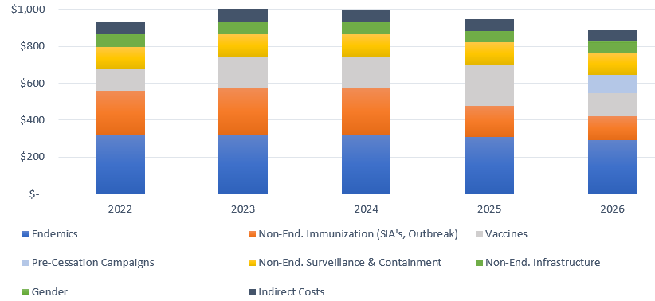
Resourcing challenges require ongoing commitment within and beyond GPEI
It is not possible to allocate money or vaccines that GPEI does not have
The epidemiology, in combination with available resources and the capacity to implement, determines programme priorities
The 2024 budget proposal includes an aggressive outbreak response that the programme considers essential to achieving interruption for Goal 2 within the next two years.
The proposal remains within the $4.8bn 5 year budget envelope but it exceeds projections for expected contributions
Challenges around resource mobilization will require important tradeoffs and increased alignment of FRR and non-FRR funding sources
Given the complexity of the certification criteria for cVDPVs which may result in different timelines for cVDPV1, 2 & 3, the financial implications of extending the interruption timeline for Goal 2 by up to two years have not been assessed
Once the GCC determines Goal 2 certification criteria, expected in November 2023, GPEI will conduct a thorough budgeting exercise and come back to POB in 2024 with a fully costed plan.
$960M
Avg. annual budget
$4.8B
2022–2026 budget
$3.3B
Current funding pledges
37%
Portion of outbreak budget consumed by WPV1/cVDPV1 response to date

Slide 16
2023 GPEI Strategic Program Review—POB
POB agreed with assessment that WPV1 eradication can still be certified in 2026 and does not foresee changes to this timeframe despite interruption efforts extending beyond 2023
POB agreed with the IMB assessment that the 2023 cVDPV2 goal will be missed; yet believes that interruption can be achieved by the end of 2025 through intensified outbreak response activities, realizing eradication by 2028.
POB endorsed the GPEI budget of $1.1B for 2024 with caveat that POB & FAC will expect an update by end November on the hard prioritization & sequencing
POB requested the MYB by end Q2 2024, after low season

Slide 17
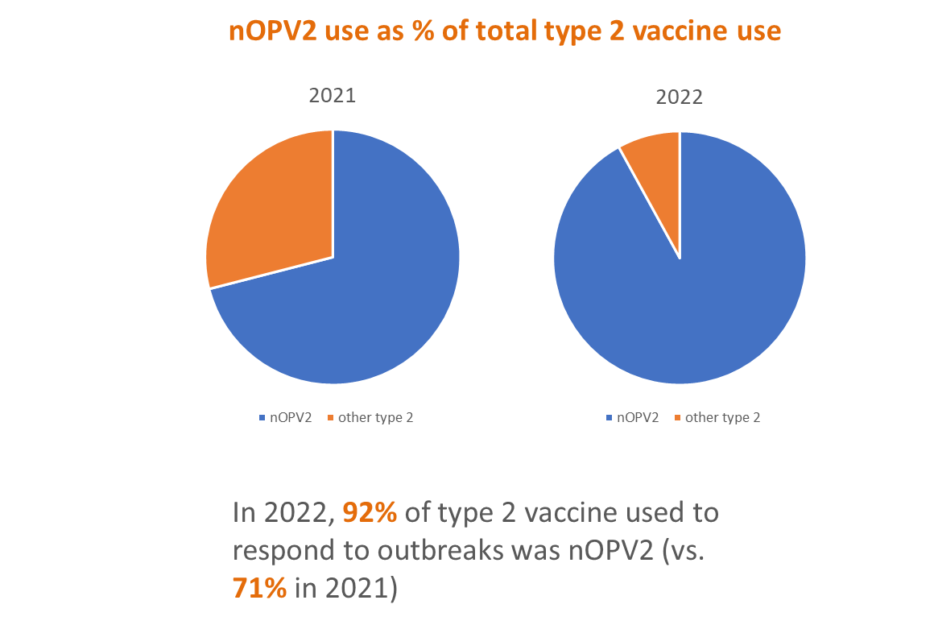
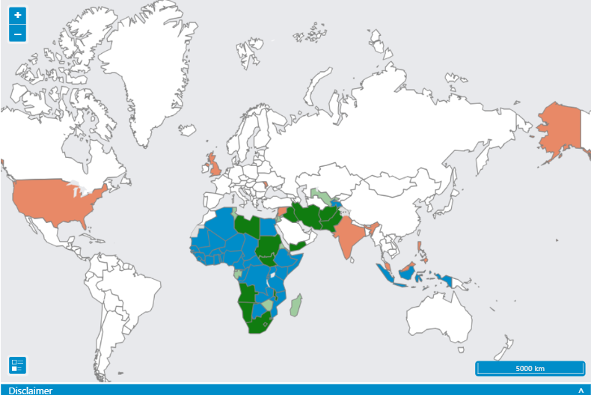
Over 820 million doses administered in 35 countries
On November 13, 2020, nOPV2 was listed under EUL as the first vaccine to be authorized through this process, and its use for outbreak response began in March 2021
Data as of 20 Oct 2023
So far, in 2023, only 1 country has used Sabin mOPV2 for outbreak response
Notes:
96.1% through Q2/2023

Slide 18
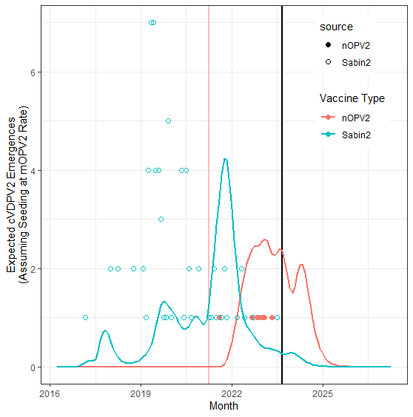
Deep Dive: nOPV2-linked emergences: substantially lower rates compared to Sabin OPV2 experience
To date, we have seen 10 emergences linked to nOPV2 use: DRC (4), CAR (2), Nigeria (1), Egypt (1), Botswana (1), Cameroon (1)
For 9/10 of these emergences, significant delays between R1 and R2 were seen, ranging from 6 weeks to 51 weeks
SAGE nOPV2 policy allows for R2 to take place 1-4 weeks after R1; GPEI SOPs indicated R2 should happen around 4 weeks after R1
If nOPV2 seeded new emergences at same rate as Sabin-2, given the scope and scale of nOPV2 use, 66 cVDPV2 emergences would be expected given total nOPV2 use to date in AFRO, EMRO, and EURO
Considering time-to-discovery, 43 (66%) of the index isolates of these cVDPV2 emergences would be expected to be seen by end August, 2023
First nOPV2 campaign
End Aug 2023
Analysis previously presented in Q2, 2023. Updated results for Aug 2023. Co-authors: Hil Lyons, Arie Voorman, Laura Cooper, Kaija Hawes.
At their October 2023 meeting, SAGE issued a new recommendation as follows: SAGE recommended that to further minimize the risk of seeding new cVDPV2 outbreaks, the novel oral poliovirus vaccine type 2 (nOPV2) should be used with a maximum interval of 4 weeks between supplementary immunization activities (SIAs)

Slide 19
IPV recommendation implementation status
For 194 WHO Member States
68 MS using 1+ doses of IPV
126 MS no IPV
All MS use at least 1 dose of IPV
95 use 2+ doses of IPV
99 MS use 1 dose (only) of IPV
SAGE IPV1 Recommendation
2013
April 2019
SAGE IPV2 Recommendation
2020
63 Gavi supported*
36 MICS/PAHO/SP
42 left to introduce
36 introduced
21 introduced
* Gavi63 support excludes the 10 Gavi IPV eligible countries that have already adopted a 2-dose schedule with fractional IPV (Bangladesh, Cuba, India, Nepal, Sri Lanka) or introduced a second dose without Gavi support (Guyana, Honduras, Syria) or switched to an aP-Hexavalent product (Armenia and Georgia)
Data as of 5 October 2023. Source WHO IPV programme tracking

Slide 20
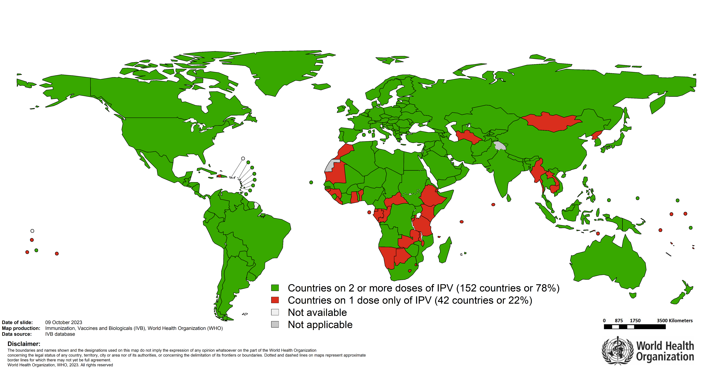
IPV in immunization schedules globally

Slide 21
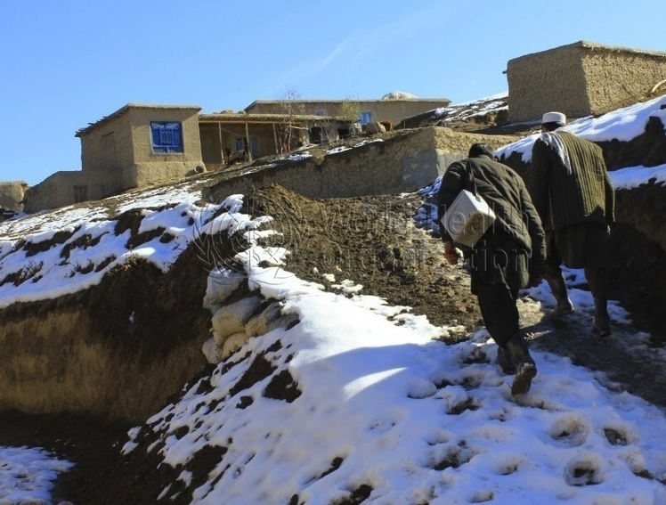
Dedication—Frontline Workers
We thank the invaluable contributions to world health by vaccinating children and delivering other health services to their communities, the Global Polio Eradication Initiative dedicates this report to frontline workers, and particularly those workers who have lost their lives.
The report is also dedicated to children, adolescents, and adults affected by polio and to the polio-affected advocates who have used their voice and experience to play a key role in the eradication effort.
Thank you.
Trekking through the snow to deliver vaccines, Afghanistan – December 2020 | © WHO / Shaim Shahin

Slide 22
Thank You

