Slide 1
The Global Polio Program’s Successes and Remaining Challenges
18th Meeting of the IMB, 29 June 2020

Slide 2
Presentation Sections
Implications of the COVID-19 Pandemic on Polio Eradication
Progress in Afghanistan and Pakistan
Africa WPV Polio-Free Certification, Nigeria update and cVDPV2 Outbreaks
Annex: Additional slides

Slide 3
Section 1
Implications of the COVID-19 Pandemic on Polio Eradication

Slide 4
Outline
COVID-19 context
Initial GPEI response & support for the pandemic response
Impact: surveillance, SIAs/EI, public perception
Risk assessment and SIAs resumption efforts
Financial Status
Challenges / opportunities and next steps

Slide 5
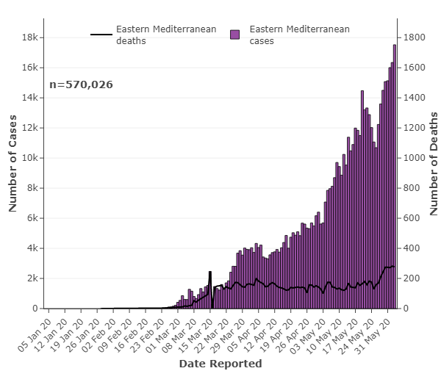
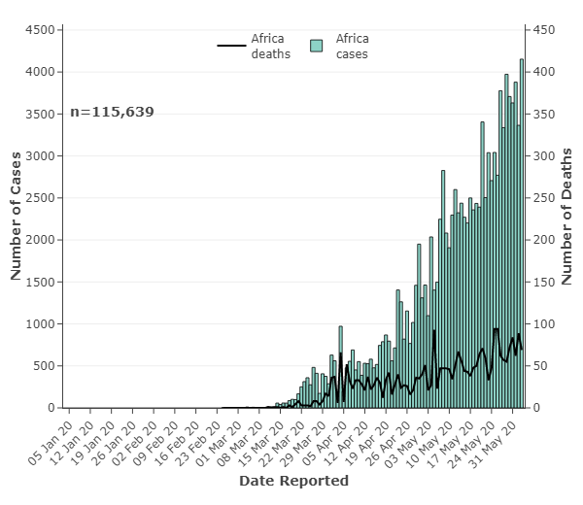
COVID-19 Context
EMR
AFR
Source: WHE
Source: WHE
I - Emergency Phase
(March– June 2020?)
- SIAs halted globally
- Critical GPEI functions continuing
II - Resumption Phase
(July/ Aug…)
- SIAs Resumption in outbreaks & WPV endemics (in coordination with EI)
III – Post/Para pandemic Phase (time ?)
- significantly lower COVID-19 risk
- long-term revisions to Endgame Strategy 2019-23
Anticipated Pandemic Evolution

Slide 6
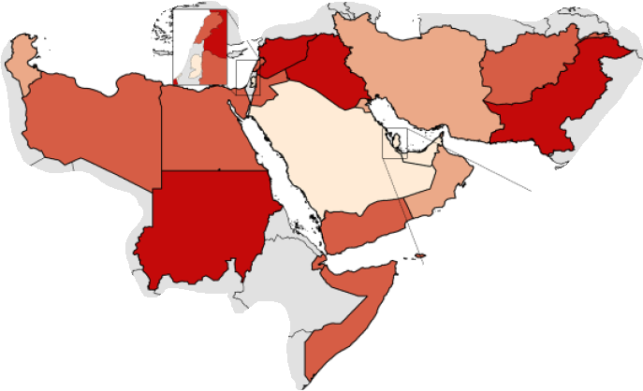
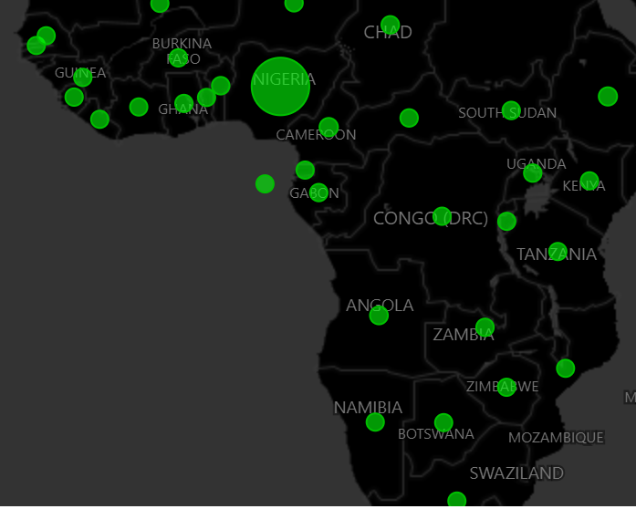
Overall / Immediate Program Adaptation
Initial GPEI POB guidance (24 March)
suspend all immunization activities in alignment with WHO global guidance on response to COVID-19
critical functions such as PV surveillance should continue
GPEI capacities supporting the pandemic response
Surveillance, GPLN, data management, risk communication
>31k staffs / contractors
SC established a ‘continuity Planning & Facilitation Group (PFG)’
to develop short term workplan & coordinate efforts within GPEI & with EI / other programs
EMR POL Surv. Network Support
AFR Country Support Map
(AFR dashboard)

Slide 7
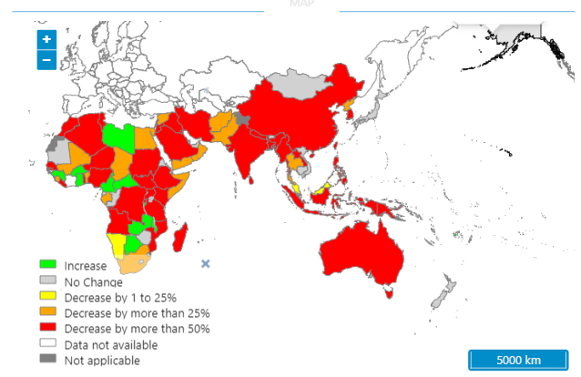
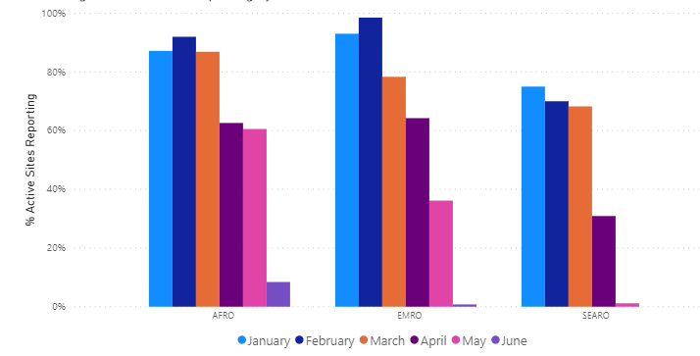
% drop in AFP Reporting; April 2019 vs April 2020
Impact on Surveillance
Widespread & significant impact on polio surveillance sensitivity
Decrease in case detection in WPR, SEAR, EMR
Decrease/halt of ES in several countries in SEAR & EMR
Major disruption in shipment of specimen in AFR
All 21 high-risk countries (including endemics, outbreak COs) are being impacted
Multiple Polio staff members across regions diagnosed with COVID-19
Need for strategic planning to ramp up to pre-COVID-19 levels
Implications of additional funding needs & technical support
% of Expected ES Samples Collected & Processed, by month 2020
(June data not complete)
Source: POLIS

Slide 8
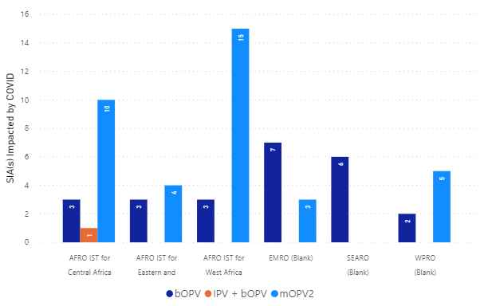
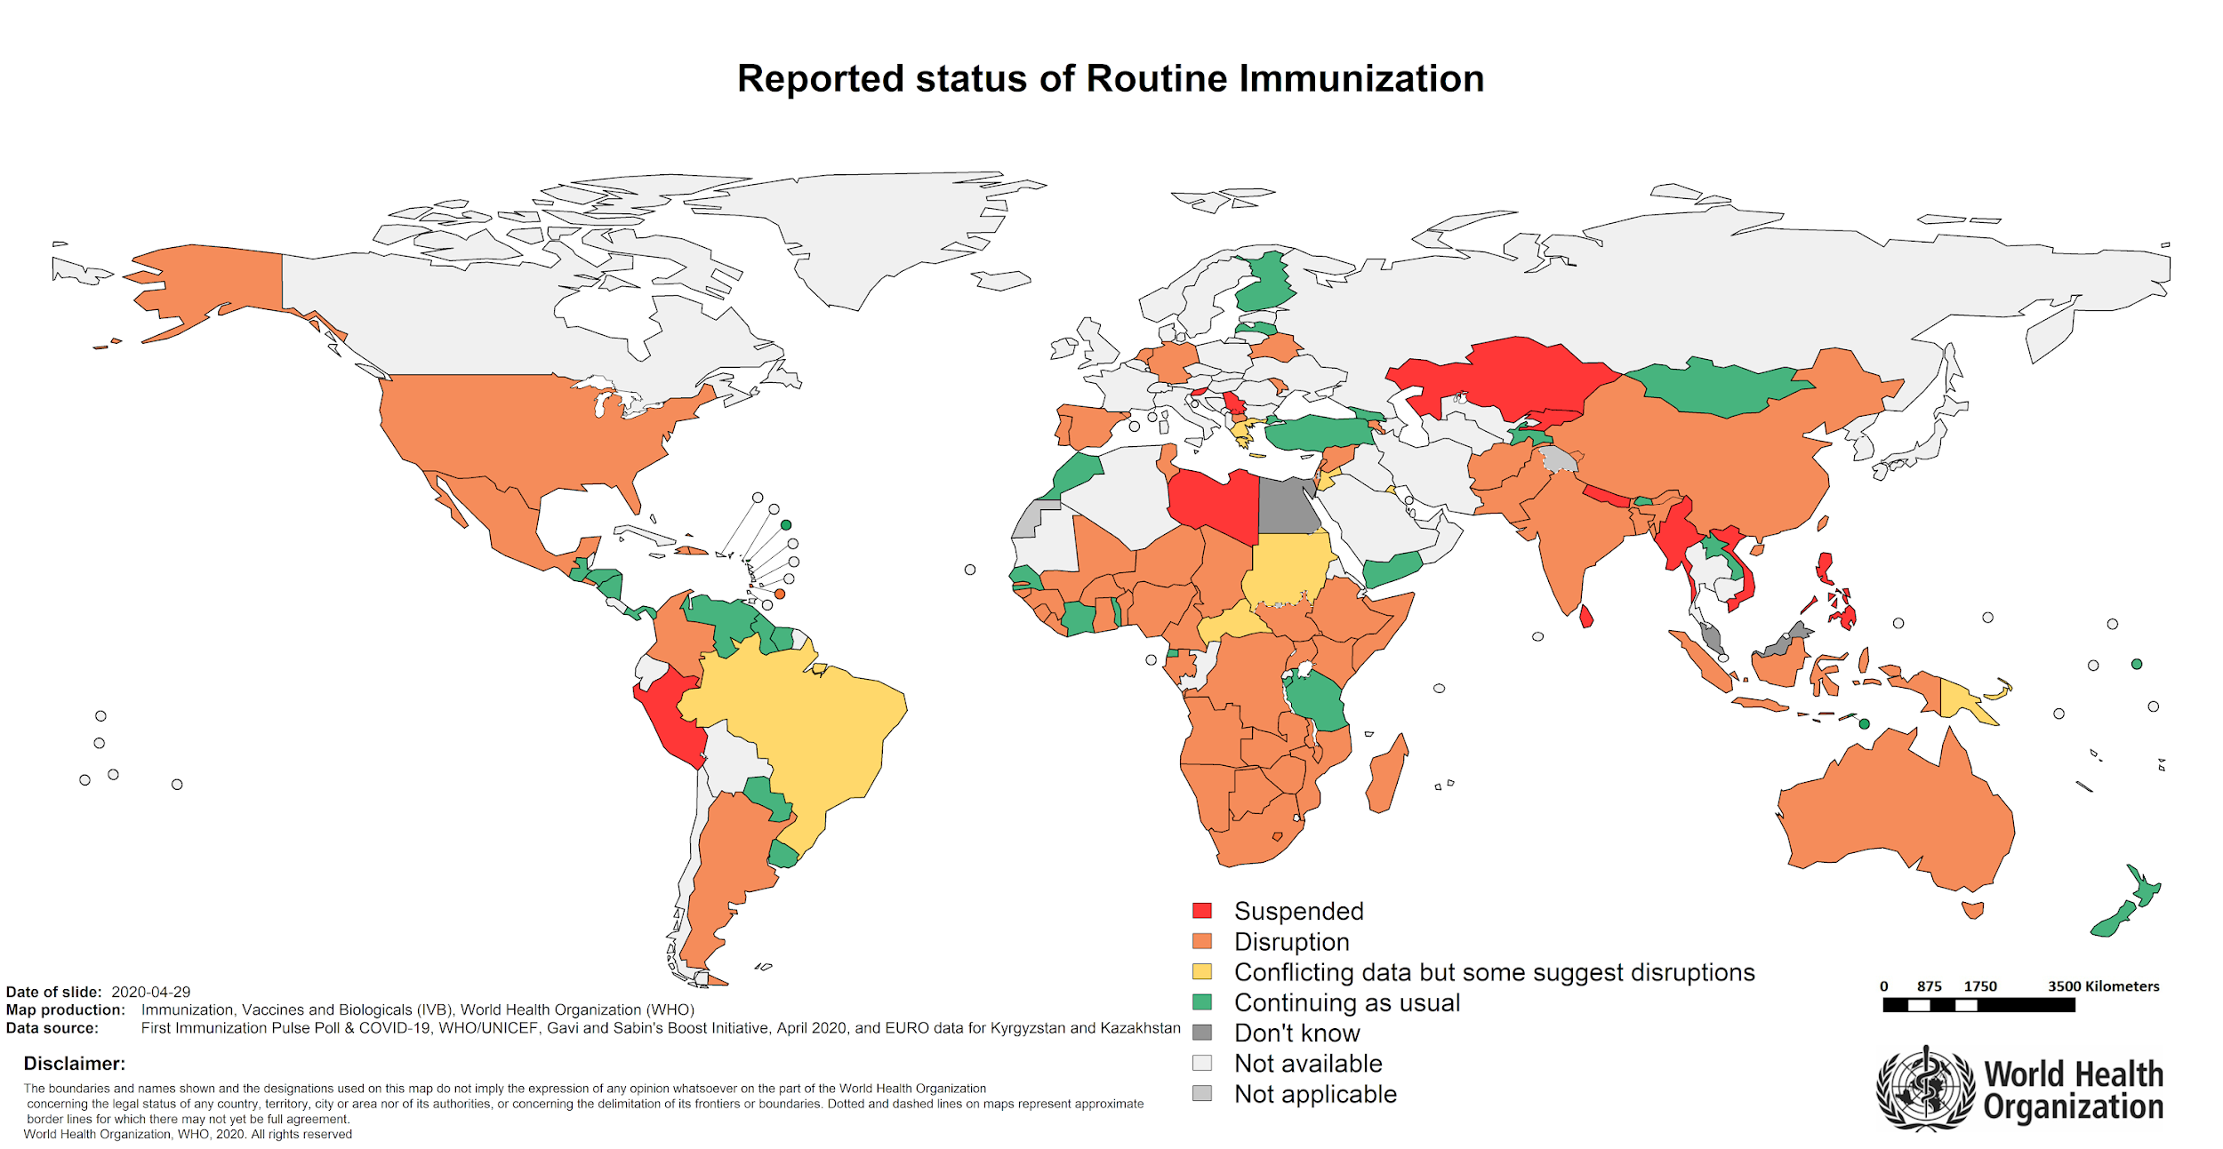
Impact on EI & Polio SIAs (as of end-May 2020)
Per GPEI / WHO guidance, all polio SIAs suspended
EPI not widely suspended but disrupted in many countries
Number of SIAs impacted by region; March-May 2020
Source: POLIS
Vaccine supplies (worth $6m) already in countries
100 million doses (worth $12.5m) procured & awaiting delivery due to interruptions
Some of above with short-medium shelf-life
Some suppliers reaching storage capacity & may stop production
Source: WHO

Slide 9
Impact on Communications
Global public perception has shifted
In countries with substantial polio assets, this infrastructure was instrumental in pandemic response, but COVID-19 is a “setback” for GPEI
‘Infodemic’ with impact on all vaccination programmes
abundance of (mis)information and rumours in digital spaces and communities
Health behaviors
Polio risk perception vs. COVID, communities more likely to refuse polio vaccine without other services they consider more urgent
Concerns of front line workers on re-start of SIAs
PPEs, perceptions of safety, virus transmission

Slide 10
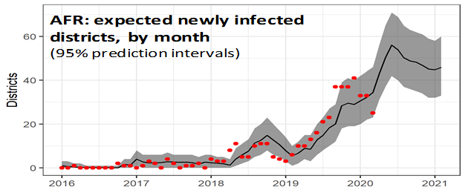
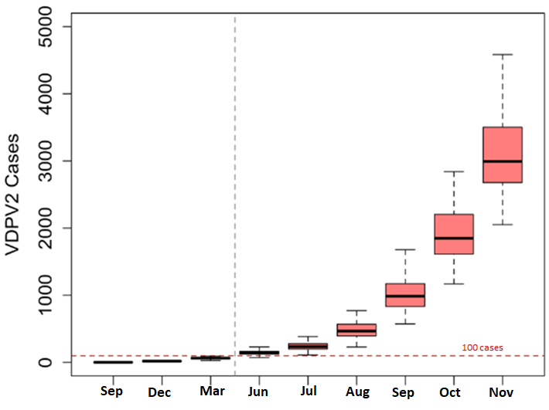
GPEI Updated Guidance (21 May), Promoting SIAs Resumption
cVDPV2 in 90 additional districts in AFR by end July. ~200% increase, if response is not resumed
Based on risk analysis & intensifying PV transmission
immediate SIAs restart planning in endemics, OB countries & resumption after risk-benefit analysis (WHO/GPEI Framework for Decision Making issued)
safety of FLWs & community is paramount
Preventive SIAs to resume when local situation permits
Stresses coordination with other progs.
Preventive SIAs schedules available & OBR scheduling underway
Ops./financial planning in process
GPEI - EI coordinating on integration
Simulated impact of Pause in AFG/PAK
Exponential rise in cVDPV2 cases if a response is not initiated
2019
2020

Slide 11
Program’s Financial Status
In line with ‘POB’s Call to Action’; GPEI capacities (HR, logistical, lab., comms.) fully mobilized to support COVID-19 response
Translating to approx. $20m / month
Significant impact of COVID-19 pandemic
Program will have to make up for the lost ground
Consideration for safety of FLWs & communities; i.e. PPE, preventive measures, training needs etc.
10% - 15% “COVID premium” being applied to the budgets
Resultantly, higher revised program costs expected in future

Slide 12
Challenges
Opportunities
Uncertainties related to Pandemic
COVID-19 epidemiology vis-à-vis polio program planning
Variable national & sub-national situations
Surveillance gaps
Declining immunity / potential for rapidly expanding outbreaks
Unprecedented challenges towards high quality SIAs
IPC / PPE, communications
Community engagement
Use the pause for reviewing the ‘game plan’
Leverage
Global discourse on COVID-19 for importance of vaccination
National Govts’ commitment & GPEI’s support for pandemic response
Momentum to integrate approaches (GPEI + EI + Essential services); win-win
PEI targets, response timelines etc. to be considered

Slide 13
Key Priorities / Next Steps
Anticipate the ‘new normal’ & review program strategies at all levels
operational adjustments (IPC/PPE, training etc.) / flexible approaches
Put community and FLWs at center of prototyping re-start of SIAs
Finalize endemics & outbreak SIAs calendar
aiming restart during mid – end July 2020
Strengthen GPEI–EI / EHS links to capture available ‘joint working’ opportunities
possible ‘add- ons’ & integration
Risk Communication with donors & public
Prioritize nOPV2 development & rollout
Technical/ operational support to address the identified surveillance gaps

Slide 14
Section 2
Overall Progress in Afghanistan and Pakistan

Slide 15
Afghanistan and Pakistan Outline
Current context, challenges and opportunities
cVDPV2 and WPV1 epidemiology and risk modeling
Resuming mass vaccination in context of COVID-19
Polio programme priorities for Pakistan and Afghanistan

Slide 16
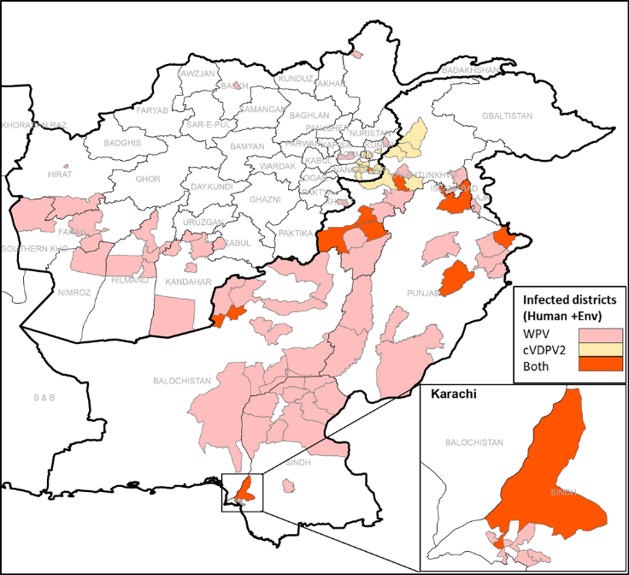
Current context, challenges and opportunities
COVID-19
COVID response a priority at all levels (government, community)
Polio infrastructure and workforce fully engaged in response, but also affected
SIAs paused since March, interruption of health services with impact on routine immunization and polio surveillance
Movement restrictions and fear in communities affecting health seeking behaviour
Opportunities
Leveraging robust all-of-government response to COVID
Changing community perception and acceptance through polio FLW involvement in COVID response
Polio programme continuity
Programme continuity plans put in place to preserve essential functions
Surveillance activities maintained, SOPs adjusted for COVID context
Co-circulation of WPV1 and cVDPV2
Threat of exponential spread of cVDPV2 by late summer
Continued WPV1 transmission and spread
WPV/cVDPV2 Infected districts during last 6 months

Slide 17
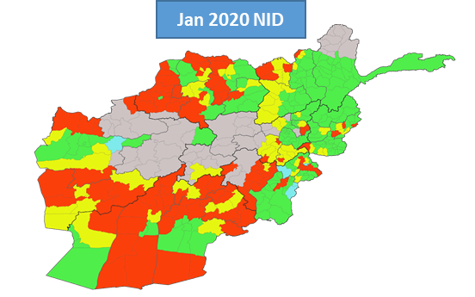
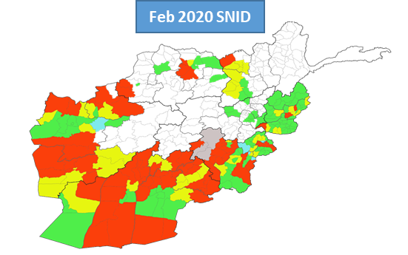
Current context, challenges and opportunities
Pakistan polio programme transformation
Acceleration and increasing ownership of transformation
Eradication as a shared priority across the political divide
Shift from PEI-EPI synergy to integration under one leadership
Laser focus on super high-risk Union Councils
Communication for Eradication Strategic Framework developed
Review of Community Based Vaccination programme conducted
Complex and fluid political context in Afghanistan
General elections and political instability
US-Taliban peace talks
Change of senior leadership in Ministry of Public Health
Ban on mass vaccination in Afghanistan
Continued ban on polio mass vaccination in large parts of the country by anti-government elements (AGE)
Integrated services plan developed targeting 10 districts of the South

Slide 18
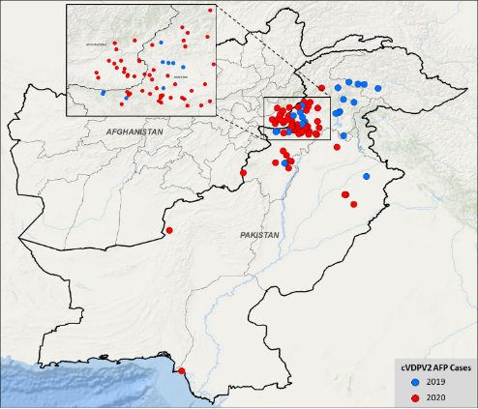
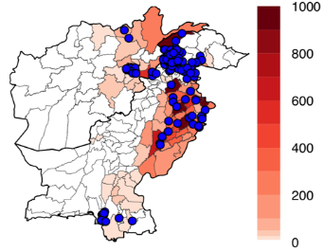
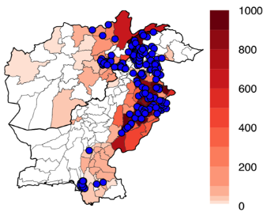
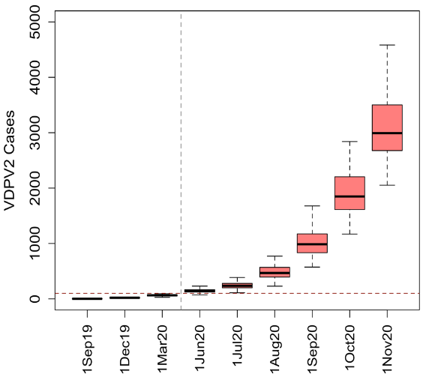
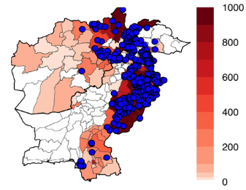
Simulated cVDPV2 transmission and cumulative cases by:
cVDPV2 cases 2019-2020
cVPDV2 epidemiology
Geographic expansion of cVDPV2
Expansion of transmission in Pakistan
Spread into Eastern Region of Afghanistan
Three instances of breakthrough transmission after mOPV2 SIAs in Pakistan
cVDPV2 modeling projections
High risk for a very large nationwide outbreak (>1,000 cases) if no SIAs with type 2 containing oral vaccine in 2020
1 Jun 2020
Number of cVDPV2 infections
1 Jul 2020
Simulated cumulative number of cVDPV2 cases
Number of cVDPV2 infections
1 Aug 2020
Number of cVDPV2 infections
100 cases
cVDPV2 case

Slide 19
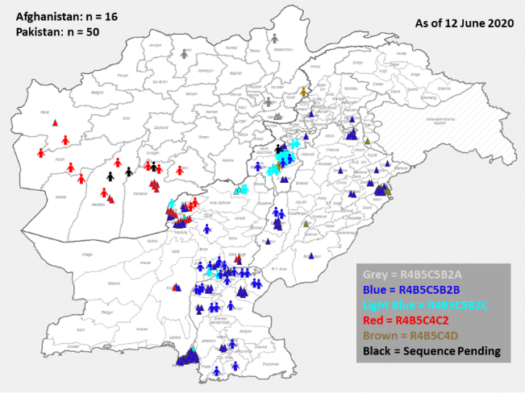
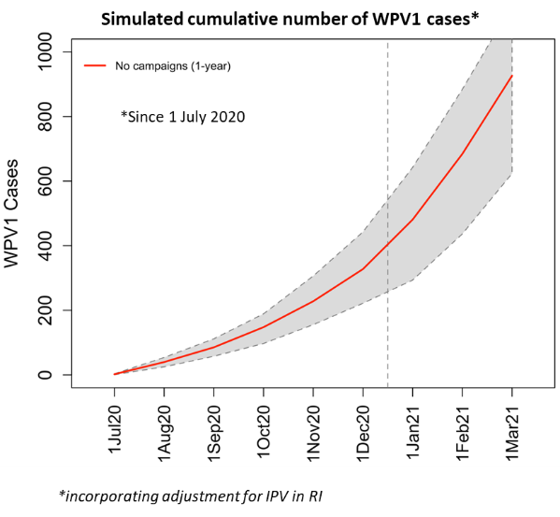
WPV1 Cases & ES+, by Cluster, 2020
WPV1 epidemiology
Ongoing widespread WPV1 transmission
South KP becoming new WPV1 reservoir
Core reservoirs of in Karachi and Quetta block with persistent transmission
Expansion of WPV1 to previously polio free areas (Sindh and Punjab in Pakistan; West and North of Afghanistan)
No WPV1 detected in core reservoirs in Peshawar/Khyber >6 months
WPV1 modeling projections
Hundreds of cases (>500) by end 2020 if no SIAs with type 1 containing oral vaccine in 2020

Slide 20
Resuming mass vaccination in context of COVID
Urgent need to resume SIAs safely
Response to cVDPV2 immediate priority while maintaining control of WPV1 transmission
Both countries geared for resumption of SIAs in July
Strong political commitment at all levels required
Understanding and addressing community concerns essential
Design SIAs within broader delivery of services (COVID response/recovery, immunization, other essential health needs)
Clear and credible communication of rationale for SIA resumption
Operational and tactical adjustments: Guidance developed to mitigate incremental risk of COVID to frontline workers and the community
Use the unprecedented national and political mobilization for COVID response and lessons learned to resume and strengthen the national programmes to finally achieve polio eradication

Slide 21
Pakistan and Afghanistan programme priorities
Eliminate cVDPV2 in 2020 without exacerbating COVID-19
Garner political and national mobilization for COVID-19 in support of polio eradication at all levels
Pakistan
Maintain control of WPV1 through targeted campaigns and outbreak response
Complete the transformation of polio eradication programme
Maintain focus on super high-risk Union Councils (SHRUCs)
Afghanistan
Interrupt WPV1 transmission in non-reservoir areas
All efforts to gain and maintain access for full-scale mass vaccination activities
Endemic areas of Southern Region
Accessible areas: Improve quality of vaccination activities
Areas where mass vaccination is banned: Implement all possible immunization activities

Slide 22
Section 3
Africa WPV Polio-Free Certification, Nigeria update and
cVDPV2 Outbreaks

Slide 23
Africa Region Nearing WPV Polio-Free
The final four countries in the Africa region--Cameroon, Central African Republic, Nigeria and South Sudan--were certified as free of wild polio virus by the Africa Regional Certification Commission (ARCC) on 18 June 2020.
The Commission will make a final decision on certifying the Africa region as free of WPV by August 2020, after a satisfactory review of updated reports from the other 43 countries in the WHO Africa Region. If certified, it would be the fifth of the six WHO regions to have eliminated wild poliovirus.
The ARCC also thanked the polio program for its support to the COVID-19 response, but noted concern with routine immunization coverage, the urgency need to stop cVPDV2 outbreaks and to continue efforts to strengthen surveillance.

Slide 24
Nigeria Update
In June 2020 ARCC certifies Nigeria as WPV free
45 months (as of June 2020) since the last WPV case was detected in Borno State
Since 2016, all LGAs in Nigeria have consistently reported at least 1 AFP case each year and both surveillance core indicators met by at least 87% of the LGAs yearly
The system has consistently detected VDPV2 since 2016, across different states. cVDPV2 from AFP cases have also been detected in areas with chronic inaccessibility (due to insurgency): Magumeri (1) and Nganzai (3) LGAs in 2018, Konduga (3) LGA in 2019, all in Borno State
no WPV has been detected despite the very wide scope of environmental surveillance – 113 ES sites in 29 states, plus the federal capital
A wide-spread, nation-wide cVDPV2 outbreak that began in January 2018 in Jigawa has been largely contained, with two positive detections in one state to date in 2020

Slide 25
Nigeria Update (cont.)
Estimated 93% decrease in U-5 children in settlements unreached by geo-tracked vaccination teams – Borno State, 2016–2020
Trend of estimated population in unreached locations from September ‘17 to February ’20 (Number)
-93%
432,345
Sep ’16
Sep ’17
Oct ’17
Nov
‘17
Dec ’17
May ’18
Oct ’18
Feb ’19
Jun ’19
Nov ’19
Feb ’20
In a bid to ensure that all children are reached, we use estimates of U-5 children living in locations unreached by any geo-tracked vaccination teams
However, 385 of the 1,150 locations unreached by geo-tracked teams have tally evidence of reach by RES, RIC and CIIA teams
These 385 locations account for an estimated 8,539 U-5 children which deducted will bring the estimated number of children in unreached locations to 22,649
A large number of the U-5 children in unreached locations might have received vaccinations at service points in neighbouring countries
Source: Borno SPHCDA, GRASPv 8.5

Slide 26
cVDPV outbreaks in Africa and Asia
Multiple, continued cVDPV2 outbreaks have been reported in the Africa region, Somalia, Pakistan, Afghanistan, Philippines and Malaysia
Africa: All outbreak response activities were suspended in March 2020 due to COVID-19, leading to a significant expansion outside of areas where mOPV2 response campaigns have taken place, or planned campaigns were postponed
Asia: expansion of cVDPV2 into new geographies in Philippines and Malaysia
The mOPV2 Advisory Group has approved mOPV2 use in Pakistan and Afghanistan, as well as 12 countries in Africa, for a ‘restart’ of outbreak vaccination activities potentially from July 2020
mOPV2 SIAs will also be restarting in Philippines and Somalia

Slide 27
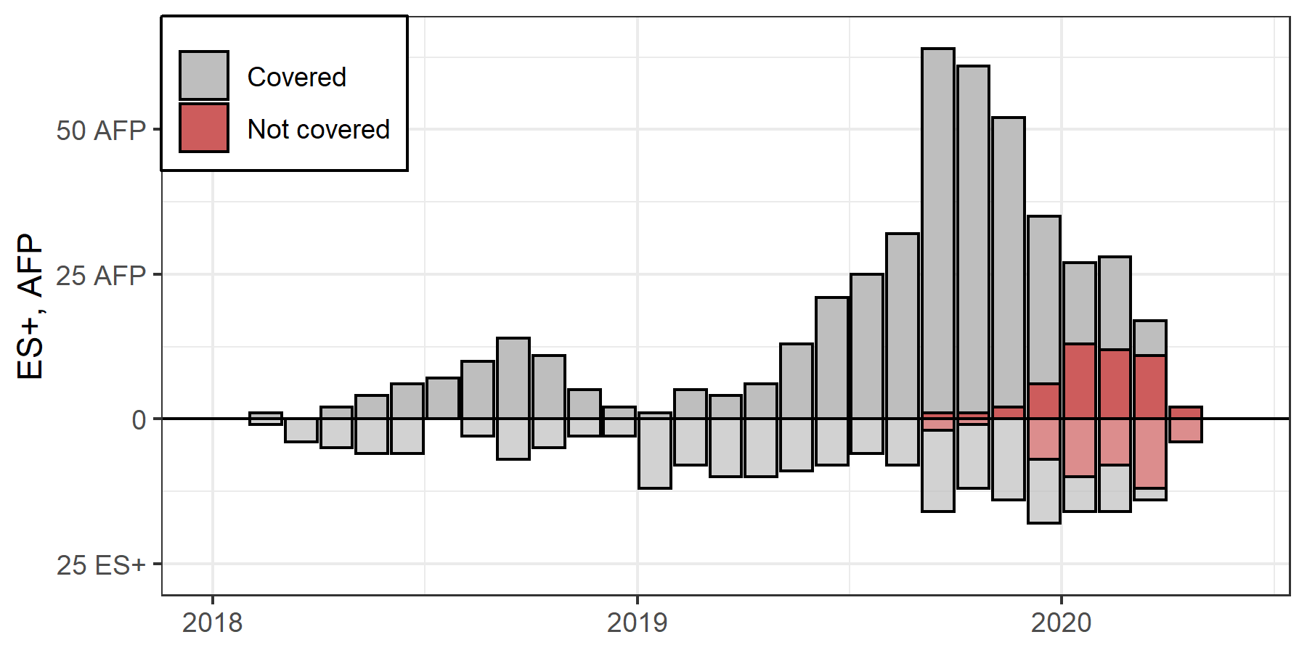
cVDPV2 summary for the African region (Jan-May 2020)
Country | cVDPV2 (AFP) | cVDPV2 (ENV) | VDPV1 | VDPV2 | Total
ANGOLA | 2 |  |  | 1 | 3
BENIN | 1 |  |  |  | 1
BURKINA FASO | 4 |  |  |  | 4
CAF | 1 | 2 |  | 1 | 4
CAMEROON | 3 | 1 |  |  | 4
CHAD | 13 | 3 |  | 1 | 17
COTE D'IVOIRE | 12 | 29 |  |  | 41
DRC | 6 |  |  |  | 6
ETHIOPIA | 13 |  |  | 1 | 14
GHANA | 12 | 17 |  |  | 29
MALI | 1 |  |  |  | 1
MOZAMBIQUE |  |  | 1 |  | 1
NIGER | 4 |  |  |  | 4
NIGERIA | 1 | 1 |  |  | 2
TOGO | 7 |  |  |  | 7
TOTAL | 80 | 53 | 1 | 4 | 138
Program
pause
Most of the areas (>80%) were infected in February or earlier.
cVDPV2 Cases and ES, by month

Slide 28
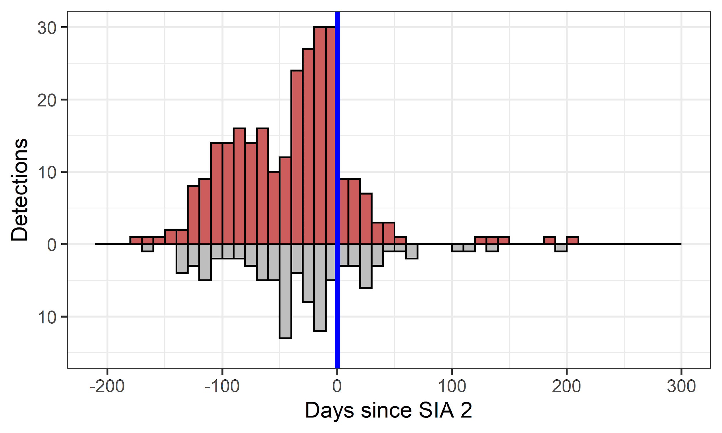
mOPV2 Rounds Largely Effective in Stopping most of the cVDPV2 Outbreaks
🡨 Before 2nd SIA
After 2nd SIA 🡪
Responses are generally effective
Few cases (<7%) have occurred after 2 mOPV2 SIAs were implemented. 77% of infected districts have had no detections after the 2nd SIA
Examples of extended breakthrough exist: Haut Lomami, Kwara, around inaccessible areas (Borno, Mogadishu)
Case
ES+
Notes:
Analysis limited to districts with >90 days of follow-up from the 2nd SIA,
and accessible areas (Borno, Mogadishu removed)
Additional interventions took place (additional mOPV2 SIAs, IPV SIAs)
SIA dates in POLIS often precede implementation

Slide 29
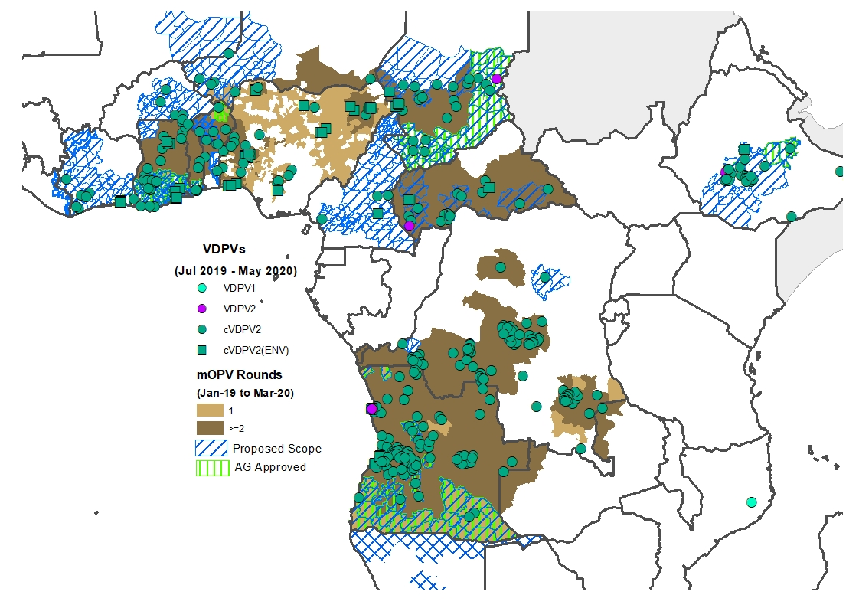
Preparing for resumption of cVDVP2 activities in Africa
Working groups established by the OPRTT, Regional Offices, and the Africa Rapid Response Team (RRT) to prepare for resumption of activities (i.e. microplanning, budgeting, preparedness tools, deployment management, weekly reporting of activities, vaccine management, C4D, etc)
Country teams including GPEI coordinators, data managers, and others briefed on the updated tools ahead of the planned restart
The Africa RRT in coordination with the Imperial College, Partners, and GPEI coordinators in countries prepared sub-regional risk assessments (see proposed scope of response in the next slide)
The OPRTT, RRT, and Regional offices are monitoring country preparedness to resume activities on a weekly basis, and continuing to provide technical guidance where needed
Surge budgets for July to December 2020 were completed to facilitate recruitment/renewal of contracts
PROPOSED SCOPE OF RESPONSE
targeting approximately 40 million children

Slide 30
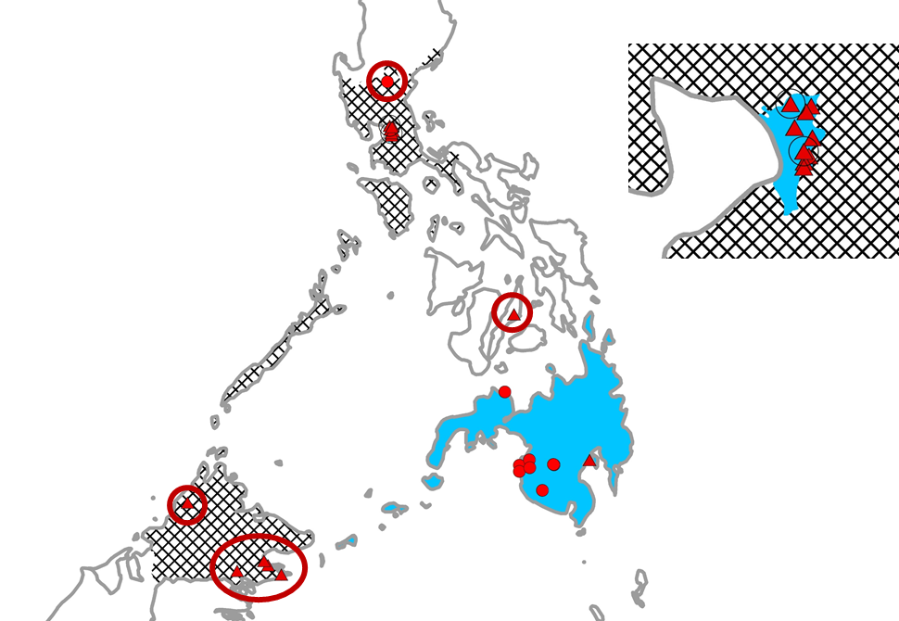
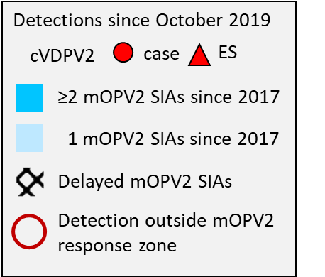
Somalia, Philippines, and Malaysia
Viruses outside mOPV2 response zones – July 2019-May 2020
Somalia
Philippines and Malaysia
Country | AFP | ES
Somalia | 0 | 17
Philippines | 1 | 1
Malaysia | 0 | 7
*last mOPV2 response in Somalia in area of virus detection was November 2018
cVDPV2 outside response zone*
No restart dates for SIAs in Somalia or Malaysia
Philippines targeting 20 July restart for mOPV2 and bOPV

Slide 31
Communication for cVDPV2 outbreaks and nOPV2
Risk and Challenges
Aligning global GPEI narrative on cVDPV2 and efforts on the ground: Polio Free Africa, vaccine-derived virus, vaccine naming (positioning)
Novel vaccine under EUL in the context of COVID Infodemics – reputational and vaccine uptake risks beyond Polio
Inadequate capacity to rapidly build immediate public momentum for an outbreak response in 120 days
Mitigation
New GPEI Global Communication Group merges external communication (PACT) with C4D and BI for coordinated planning and execution across all levels
Formative research on perceptions of nOPV2 of caregivers, FLWs, and reporters in Africa informed comms planning, products and tools
Crisis communication and scenario building cuts across media response, digital spaces, and FLW preparedness
Standardized outbreak package for field use – modular, quick adaption: Q&As, abridged FLW module and cVDPV2 products for communities and health systems
Notes:
Speaker Notes:
Disconnect in GPEI global narrative with programme perception on the ground – explaining cVDPV2 in Africa after certification, “vaccine-derived” viruses name is addressed through more coordinated approach between external communication and C4D branches of GPEI, driven by field knowledge and accounting for global need to maintain donor confidence and support of the programme. A new group brings broad range of communication expertise from GPEI into one stream to align communication strategies and tactics.
Novel OPV2 introduction for cVDPV2 response, a genetically-modified vaccine proposed under emergency use listing in the context of COVID is a challenge on its own. GPEI recognized the communication complexity at various levels, where the vaccine brings new hope to GPEI and donors globally, but positioning this vaccine as “magic bullet” in the field would be counterproductive. GPEI conducted formative research to better understand perceptions and potential concerns of various audiences to come up with right positioning of the Novel OPV2 with tailored messaging based on the need and level of knowledge. Crisis communication in response to vaccine-related events is central and integrated across external and C4D streams of the programme. Using social listening and rumor tracking in digital spaces becoming a more central piece of the programme.
As communication has to stay ahead of the game, there has been traditionally a challenge to build up enough momentum quickly within 14 days before the first round in outbreaks, where existing GPEI capacity is scarce. The programme responded with developing a standard communication package to accompany the SOPs that can quickly be tailored, adapted and used by the Governments and GPEI teams.

Slide 32
Key messages to the IMB
Spread of cVDPVs might be greater than the current picture due to the pause in outbreak SIAs and surveillance disruptions. There is a need to expand the response scope to get ahead of the virus.
Funding remains a challenge and carrying out polio activities during the COVID-19 pandemic will increase operational costs. GPEI needs to work towards more national funding and ownership.
COVID is likely to be with us for sometime, so there will be a need for ongoing adjustment to polio field operations.
GPEI should take all necessary measures to avoid any more delays in introducing nOPV2.

Slide 33
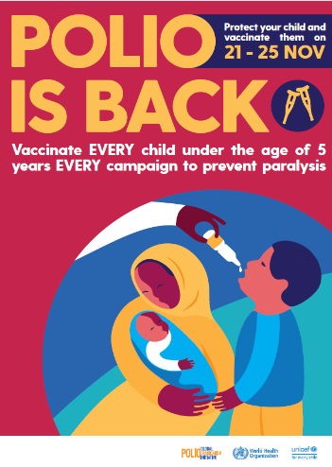
Thank You

Slide 34
Annex

Slide 35
Additional slides: COVID impact

Slide 36
Platform & assumptions
Anticipated COVID-19 Pandemic Evolution
I - Emergency Phase (active transmission / rising cases; since April – June 2020?)
- Polio vaccination, along with all mass immunization activities, halted globally
- Critical GPEI function to continue as priority (e.g. PV surveillance)
- Polio staff re-directed in support of pandemic response
- Programmatic impact of COVID-19 requires close monitoring along w/ preparations for Phase II.
II - Resumption Phase (if/when COVID-19 situation allows and/or Polio epidemiology necessitates; July? …): -
- Resumption of polio vaccination to address both outbreaks & WPV eradication, as part of a restart of essential immunization
- Staff pivot back to polio duties.
- Adapt short - medium term strategies, as necessary and identify pathway towards phase III
III – Post/Para - pandemic Phase (time ?):
- Period with significantly lower risk of Covid-19 that permits further expansion of other public health initiatives. Incorporates long-term revisions to the current Polio Endgame Strategy 2019-23

Slide 37
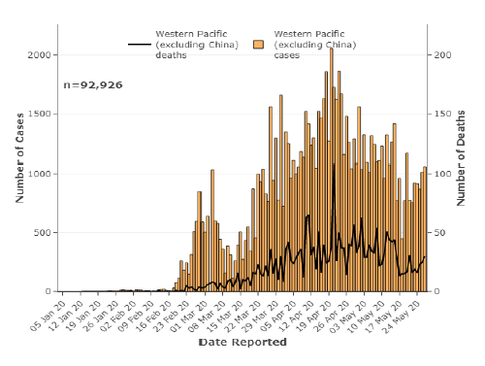
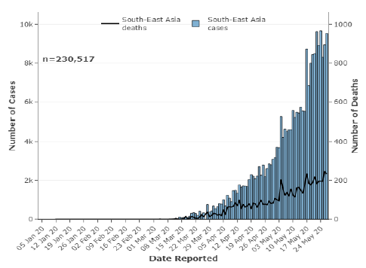
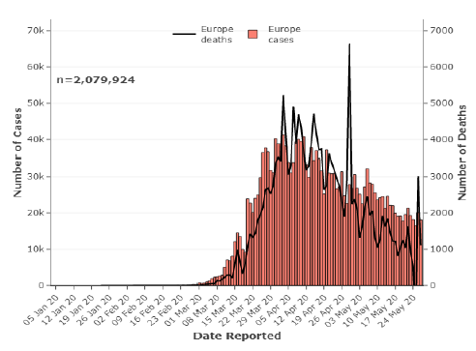
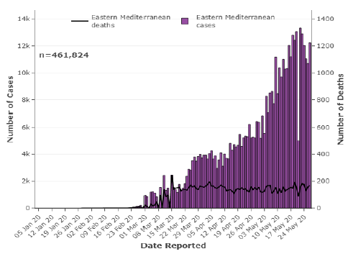
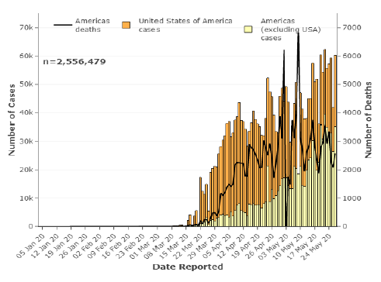
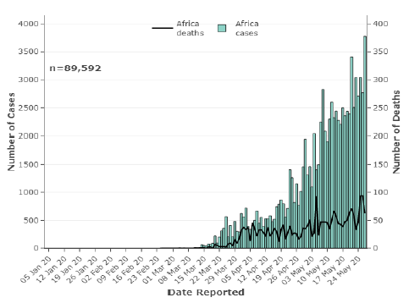
Situation as of 29 May 2020 (source: WHE)
WPR
SEAR
EUR
AFR
EMR
PAH

Slide 38
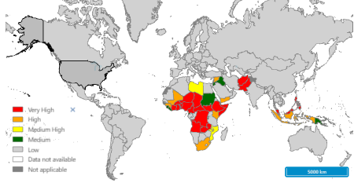
Combined Risk: (Polio Surveillance & COVID-19 (as of 12 June)
 |  | Polio Risk
 |  | High | Med-High | Medium
COVID-19 Risk | High | 1 | 3 | 7
 | Medium | 2 | 5 | 8
 | Low | 4 | 6 | 9
38
38

Slide 39
Critical Functions Identified to address COVID-19 Impact
Strategic Guidance & coordination
Coordination
Surveillance for Polioviruses
Endemics & Outbreak Response
Prevention SIAs & EI
Impact Monitoring & Risk Analysis
Operational Technical Guidance
GPEI operational planning

Slide 40
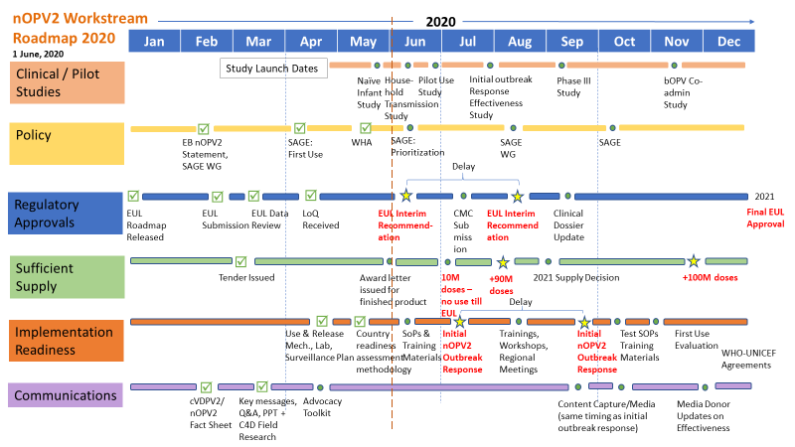
Impact on Vaccine Supply & Development
Suspension of SIAs has led to interruption in OPV deliveries
some suppliers reaching cold chain capacity, and may stop production
Major disruptions of international airfreight & increasing freight rates; & 25 destinations can’t be reached except charters
Delays currently 3 months due to COVID, but for some campaigns to be pushed to 2021 (AFR), shelf life may become an issue both on doses already delivered in the countries, but also for stocks with suppliers due to reduced demand
Closing borders in producing / receiving countries
Impact of reduced demand: Likely very high stock levels globally across suppliers at the end of 2019, increasing the perception of risks of being in the OPV market due to considerable swings in demand, risks of write off due to short shelf life (and risk of future shortage if produced doses are not put to use) increased capital costs tied up in stocks
nOPV2 workstreams progressing but challenges from COVID-19
Source: WHO

Slide 41
GPEI Roadmap for Continuity Planning & Program Ops.
(gradient fill indicates link with EI)
May
June
July
Updated GPEI recommendations
(issued 21 May)
Strategic Guidance
WHO/UNICEF/Gavi HoA statement on immunization*
(22 May)
Strategic & Operational Guidance on preventive SIAs (Polio / VPDs) ??
Updated Surv. Guidance
(issued 02 June)
Updated GPEI Continuity Planning Doc.
(issued 16 May)
Op/ Tech. Guidance
Guidance on Infection Prevention & Control (IPC)
(29 May)
Field Guides for SIAs Implementation
(end-June / early July?)
Framework for decision-making* (issued 22 May)
Maintaining essential health services (1 June)
Outbreak & AFG/PAK SIAs
Op. planning
POL Prev. SIAs plan 2020 endorsed
Revised SIAs plans for OBs, endemics
(EOMG/OPRTT/ ROs, Hub) End June / early July
Prev. SIAs?
*gradient fill indicates link w/ EI

Slide 42
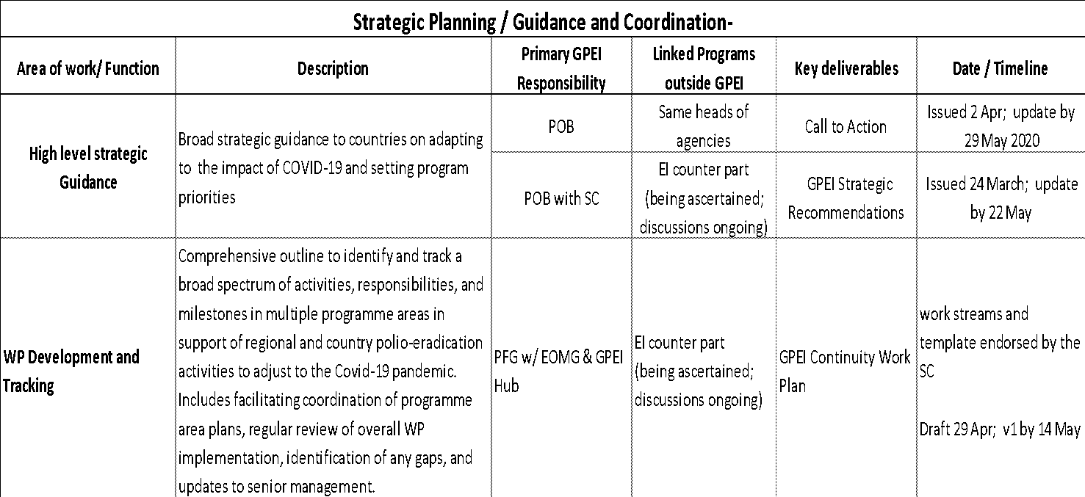
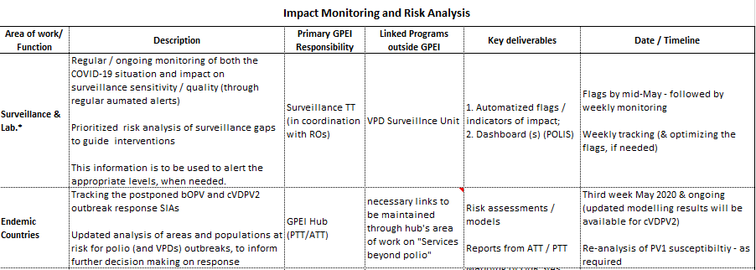
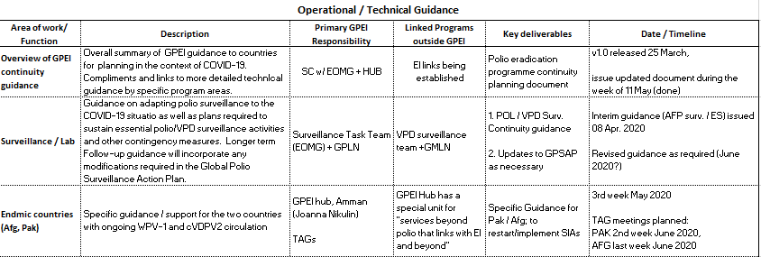
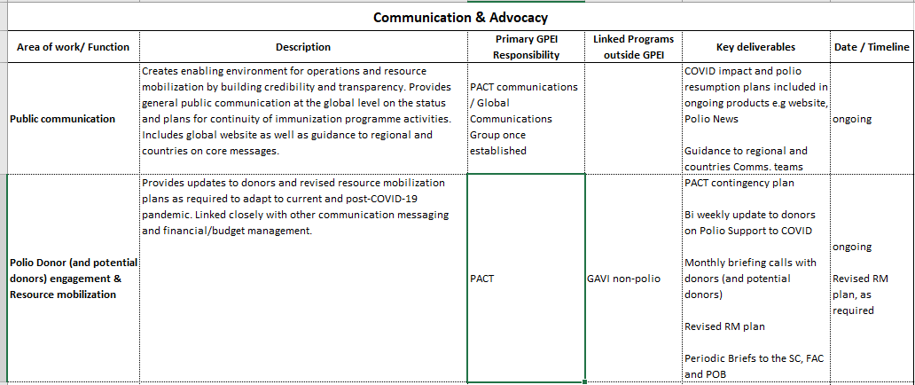
GPEI Continuity Workplan v1.0, now on GPEI Share Point

Slide 43
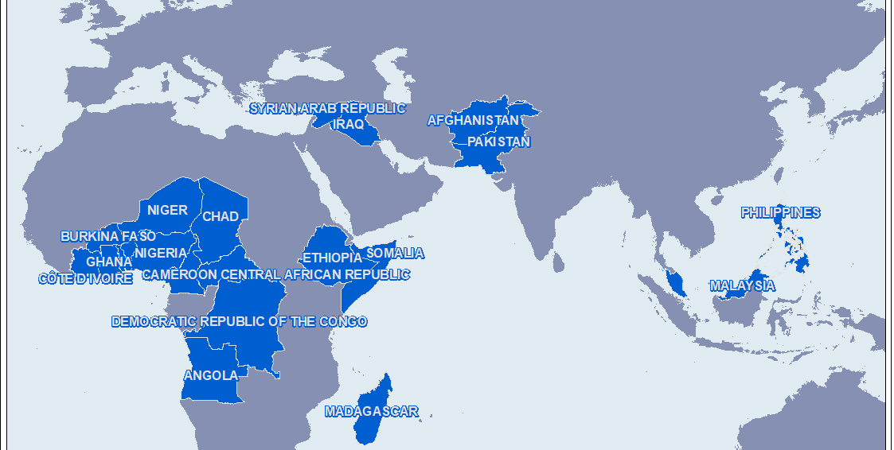
Countries with Polio Activities Postponed due to COVID-19 Pandemic

Slide 44
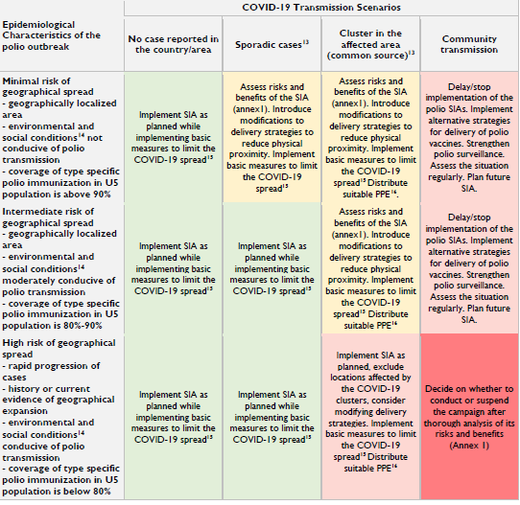
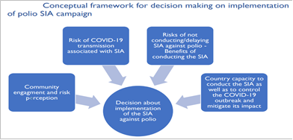
Decision Making Model / Framework for Resuming / Implementing Polio SIAs (Annex from Polio Continuity Planning document, May 2020)

Slide 45
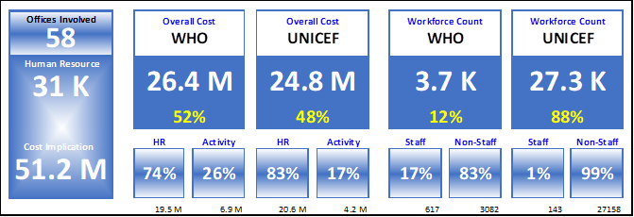
GPEI (UNICEF / WHO) Cost Implications for Supporting COVID-19 (Apr – Jun 2020)

Slide 46
Additional slides: Africa WPV free certification, Nigeria and Outbreaks

Slide 47
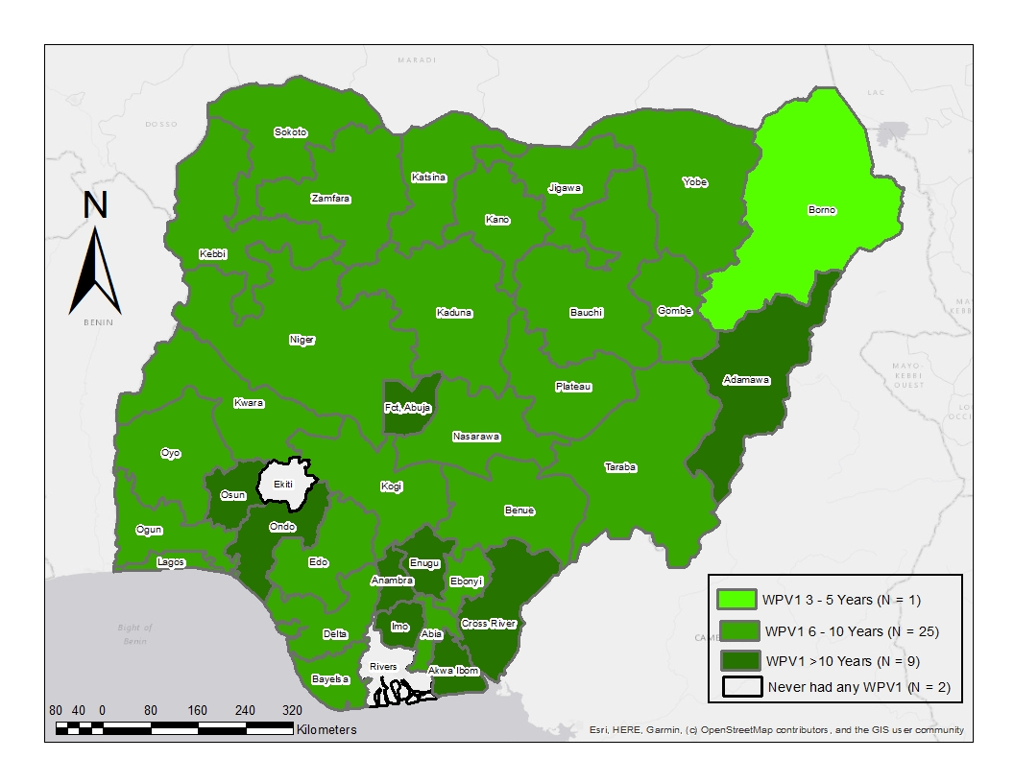
> 3.5 Years Since WPV Detection in Nigeria
4 WPV1 cases reported in 2016 in Borno State
5 OBR SIA rounds conducted within 5 months, covering 18 states
High quality (around 90% of LGAs surveyed achieved ≥90% LQAS)

Slide 48
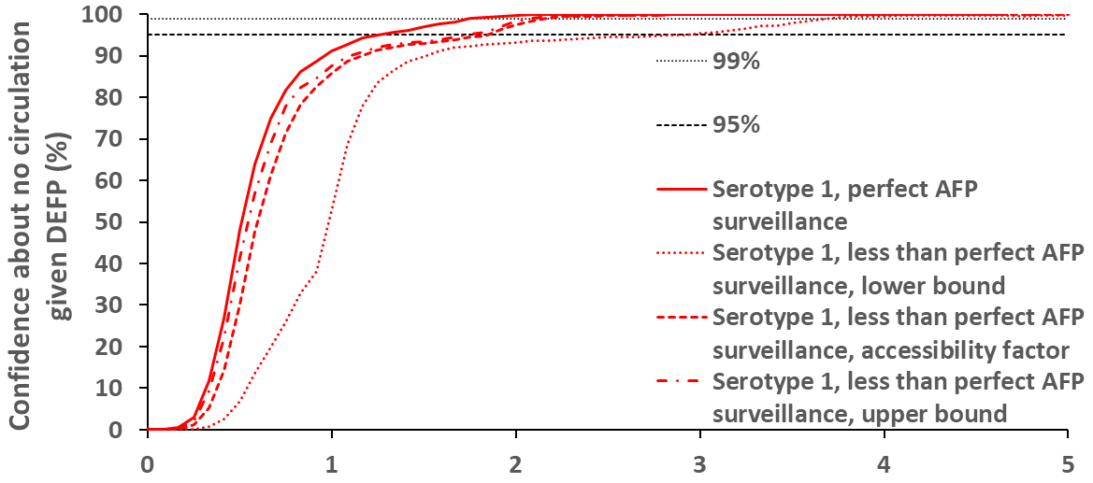
Large gains in vaccination reach, surveillance coverage, and data quality, coupled with drastic changes in population dynamics in Borno, have made ongoing transmission of WPV exceedingly unlikely in Borno and the Lake Chad Basin.
Confidence about no circulation given no WPV1 detection (%)
Years since WPV1 detection
June 2020 ARCC Review
Kalkowska DA, et al. Risk Analysis. 2020

Slide 49
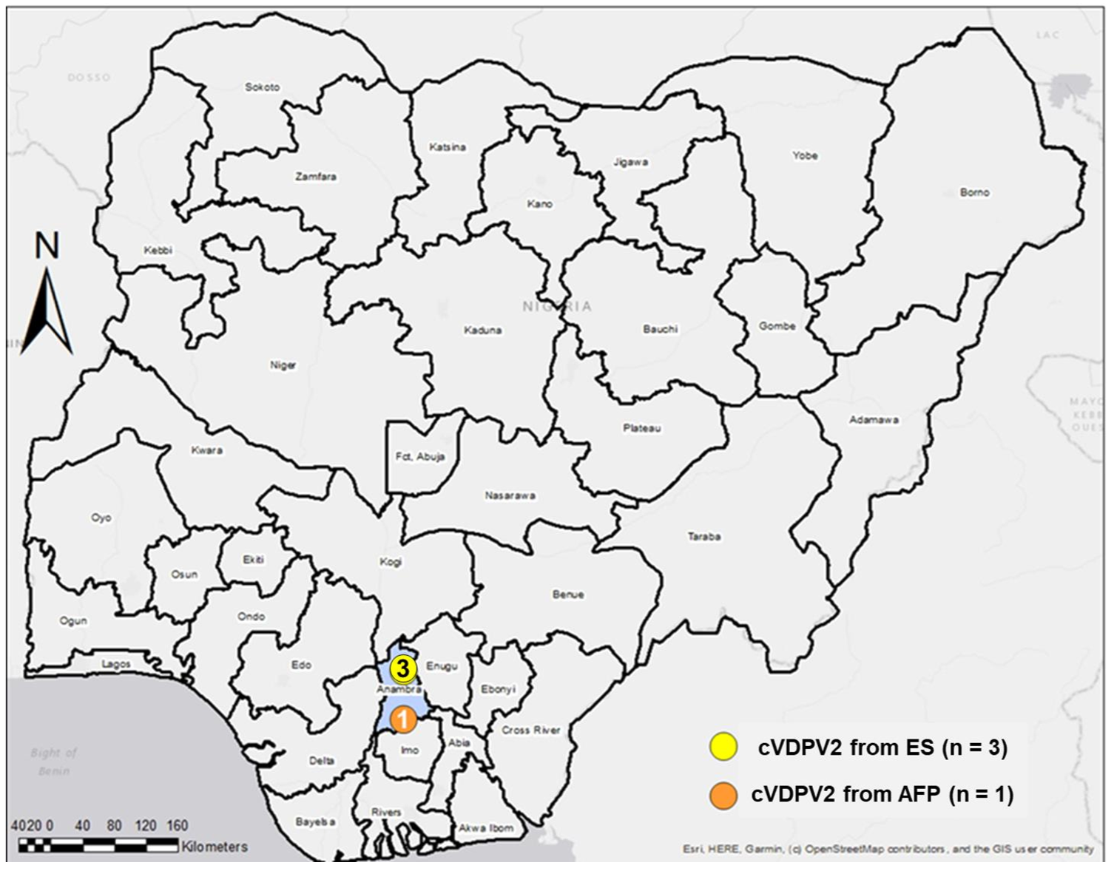
Decrease in cVDPV2 Detections from 141 in 2018 to two in 2020
2 cVDPV2 detections in Nigeria in 2020, both in Anambra State, Southeast Zone
3 local mOPV2 rounds (September 2019 – February 2020)
cVDPV2 Detections, 2020
cVDPV2 by Source
1
1
1

Slide 50
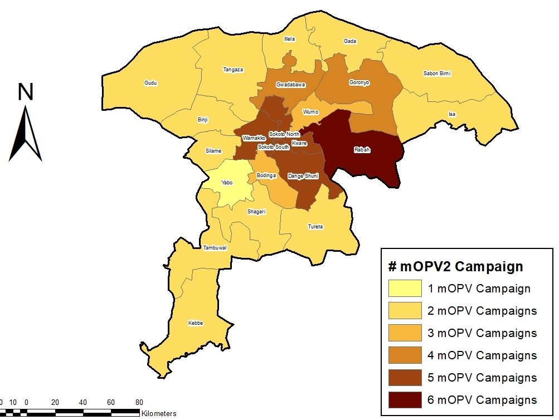
Sokoto Risk Assessment: No Need for Additional mOPV2 Outbreak Response Activities
8 May 2020: Three ES samples collected in July, August, September 2019 were reclassified as cVDPV2 after linkage to Niger/Mali
19 May 2020: Sokoto risk assessment concluded no additional mOPV2 OBR required due to 6+ high quality rounds (≥90% LQAS)
mOPV2 SIA
mOPV2 Campaign Coverage in 2019
cVDPV2 by Source
50
Note: 1 VDPV2 from an ES sample collected 18 February 2020 pending classification

Slide 51
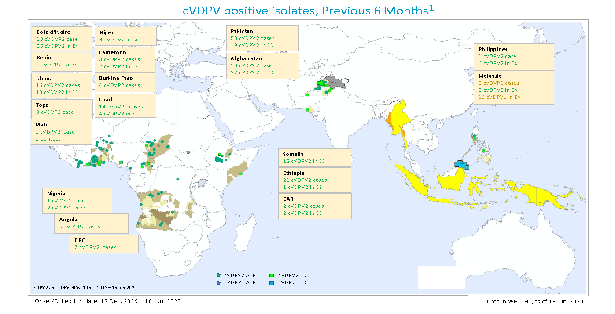
cVDPV positive isolates, Previous 6 months
Ongoing cVDPV2 outbreaks in 19 countries
15 countries in Africa, with distinct outbreak foci in West Africa, Chad-Cameroon-CAR, DRC-Angola, Ethiopia, and Somalia
Spread of cVDPV2 outbreak from Pakistan to Afghanistan
Related cVDPV2 and cVDPV1 outbreaks in Philippines and Malaysia
All countries postponed planned mOPV2 and bOPV SIAs by late March and outbreak responses have not resumed

Slide 52
Viruses outside mOPV2 response zones: July 2019- May 2020
Jul – Dec 2019 VDPVs Outside Response Zone
COUNTRY | cVDPV2 (AFP) | cVDPV2 (ENV) | TOTAL
BENIN | 1 |  | 1
CHAD | 3 |  | 3
COTE D'IVOIRE |  | 7 | 7
DR CONGO | 3 |  | 3
ETHIOPIA | 5 | 2 | 7
TOGO | 1 |  | 1
TOTAL | 13 | 9 | 22
Jan-May 2020 VDPVs Outside Response Zone
Country | cVDPV2 (AFP) | cVDPV2 (ENV) | VDPV1 | VDPV2 | TOTAL
BURKINA FASO | 2 |  |  |  | 2
CAMEROON | 3 | 1 |  |  | 4
CHAD | 7 |  |  | 1 | 8
COTE D'IVOIRE | 12 | 29 |  |  | 41
DRC | 1 |  |  |  | 1
ETHIOPIA | 6 |  |  | 1 | 7
GHANA | 8 | 1 |  |  | 9
MALI | 1 |  |  |  | 1
MOZAMBIQUE |  |  | 1 |  | 1
NIGER | 4 |  |  |  | 4
TOGO | 5 |  |  |  | 5
TOTAL | 49 | 31 | 1 | 2 | 83

Slide 53
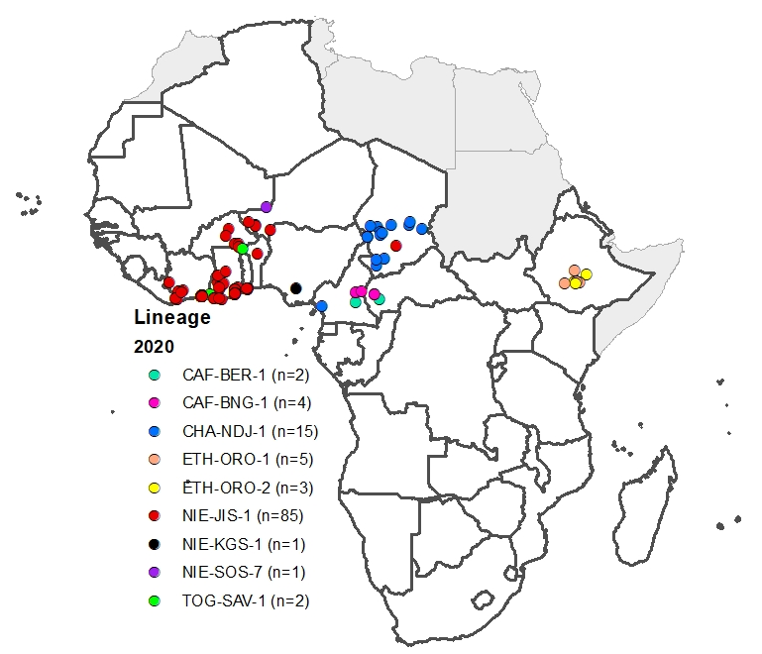
cVDPV2 lineages in AFRO: 2019 and 2020
2019
2020
Decrease in the number of lineages causing AFP cases in 2020 compared to 2019
NIE-JIS-1 (85) and CHA-NDJ-1 (15) most responsible for continued transmission

Slide 54
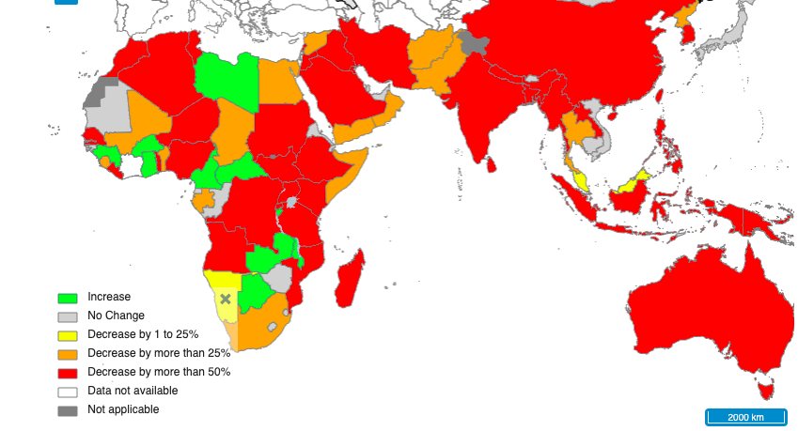
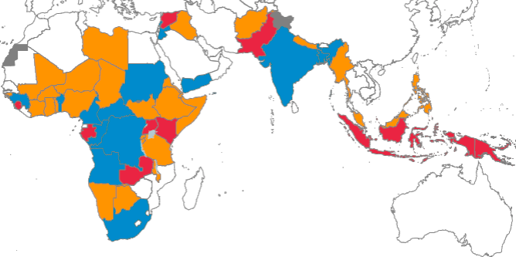
Non-Polio AFP Rate – April 2020 compared to April 2019
Non-polio AFP rates have decreased in April 2020 compared to April 2019
The percentage of ES sites reporting has decreased in March-May 2020 across regions, particularly in AFRO and EMRO
Domestic and International specimen transport delays are impacting countries globally
Specimen transport delays
AFRO
EMRO
SEARO
Percentage of active ES sites reporting – January-June 2020
Source: COVID Flags dashboard (POLIS)

Slide 55
Impact of COVID-19 Pandemic in AFRO
NP-AFP Rate April 2020 compared to April 2019
Immunization: pause in polio SIAs starting March 2020. Many cVDPV2 outbreaks unaddressed
Surveillance: Decreases in NP-AFP rates and delays in sample shipment impair ability to assess risk.
3. Epidemiology: Social distancing measures being relaxed across the Region.
COVID-19 case increase may further delay resumption of campaigns.
AFP Cases Pending Classification
Restart of activities under discussion with countries
Source: COVID Flags dashboard (POLIS)

Slide 56
Impact of COVID-19 : Samples pending shipment to GPLN as at 5th June 2020
Country | # AFP samples | # ES samples | Total
Guinea | 161 | 10 | 171
Nigeria | 144 | 38 | 182
Angola | 88 | 27 | 115
Democratic Republic of the Congo | 137 |  | 137
Malawi | 71 |  | 71
Madagascar | 52 |  | 52
Niger | 36 | 8 | 44
Uganda | 34 | 4 | 38
Congo | 24 |  | 24
Benin | 15 | 2 | 17
Gambia | 10 |  | 10
Burkina Faso | 9 | 3 | 12
Equatorial Guinea | 2 | 12 | 14
Mozambique | 12 |  | 12
United Republic of Tanzania | 7 |  | 7
Chad | 7 |  | 7
Eswatini | 4 |  | 4
South Sudan | 4 |  | 4
Gabon | 4 |  | 4
Burundi | 2 |  | 2
Lesotho | 1 |  | 1
Guinea-Bissau | 2 |  | 2
Total | 826 | 104 | 930
Outbreak Countries Pending Samples AFP-826, ES - 104

